Slide 1
NEW Contact View

Slide 2
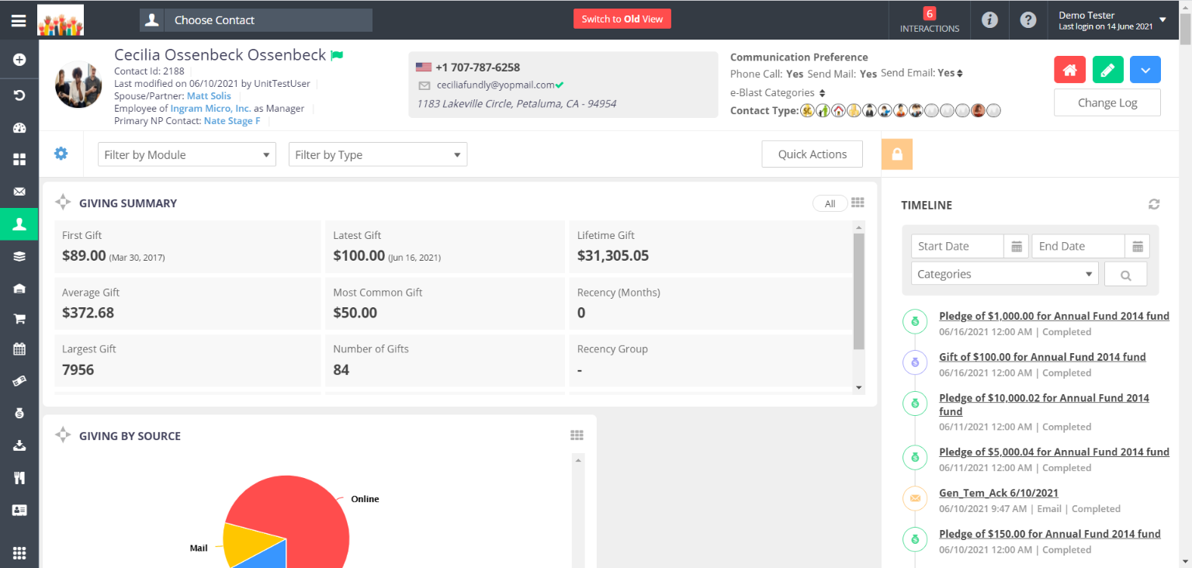
Contact Header

Slide 3
In the contact header, you will see a contact's basic information, such as Contact Name, Contact ID, Primary Phone Number, Primary Email Address, and Communication Preferences. If the contact has any "Crucial Information" entry, this will show as a green flag next to the contact's name.

Slide 4
In the upper right are action button to: a) access Household View (for contacts in a household) b) Edit the contact record c) access More Information
d) access the Change Log.

Slide 5
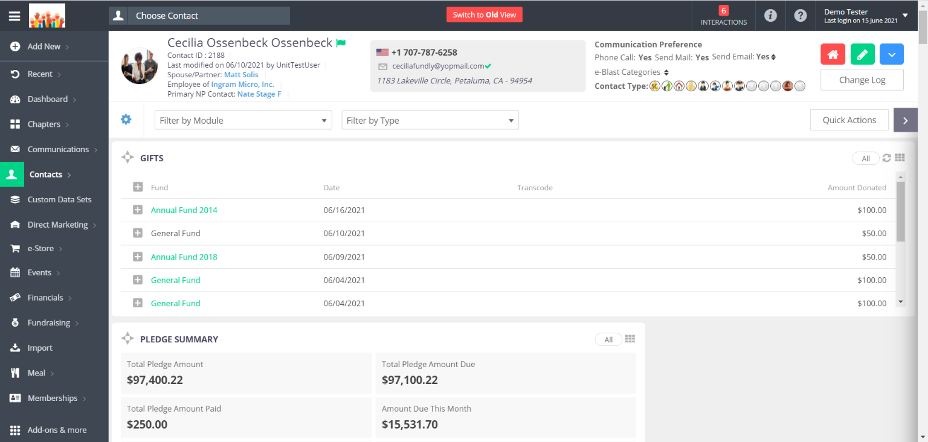
More Information

Slide 6
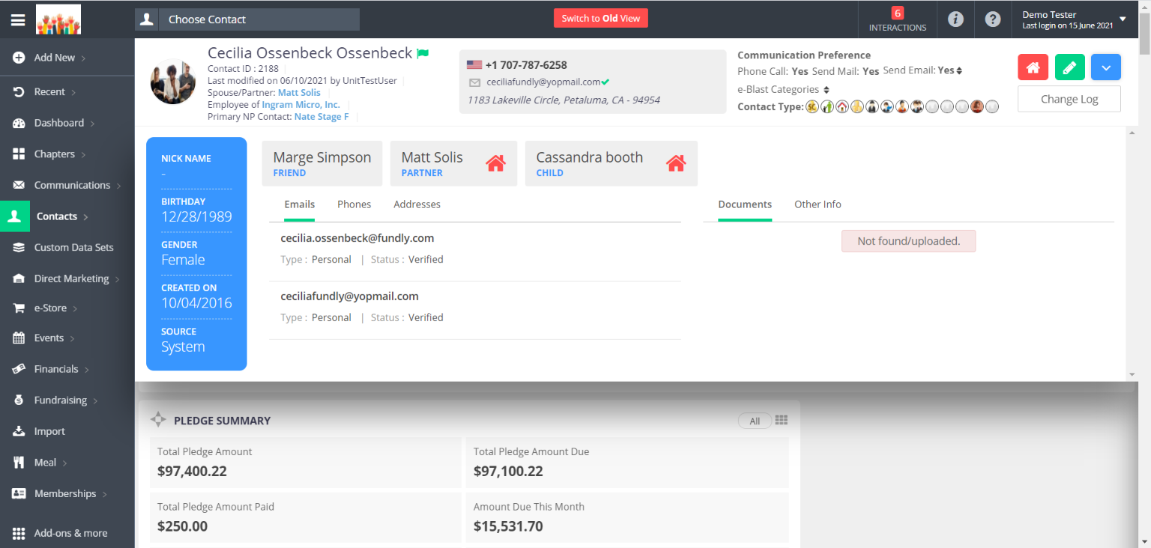
The More Information button opens a panel and shows additional information about the contact, such as demographic information for individuals, website and year founded for organizations, all Phone Numbers, Email Addresses, and Addresses, and any documents that have been uploaded to the record.

Slide 7
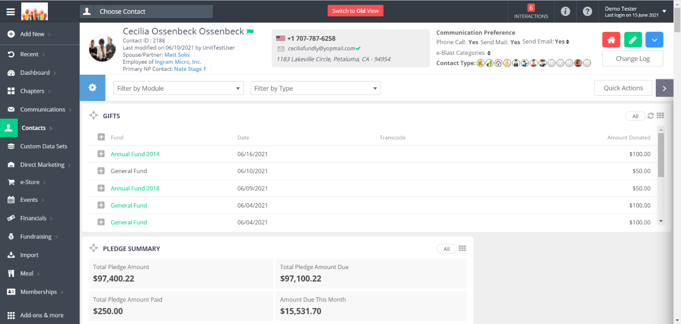
Available Widgets

Slide 8
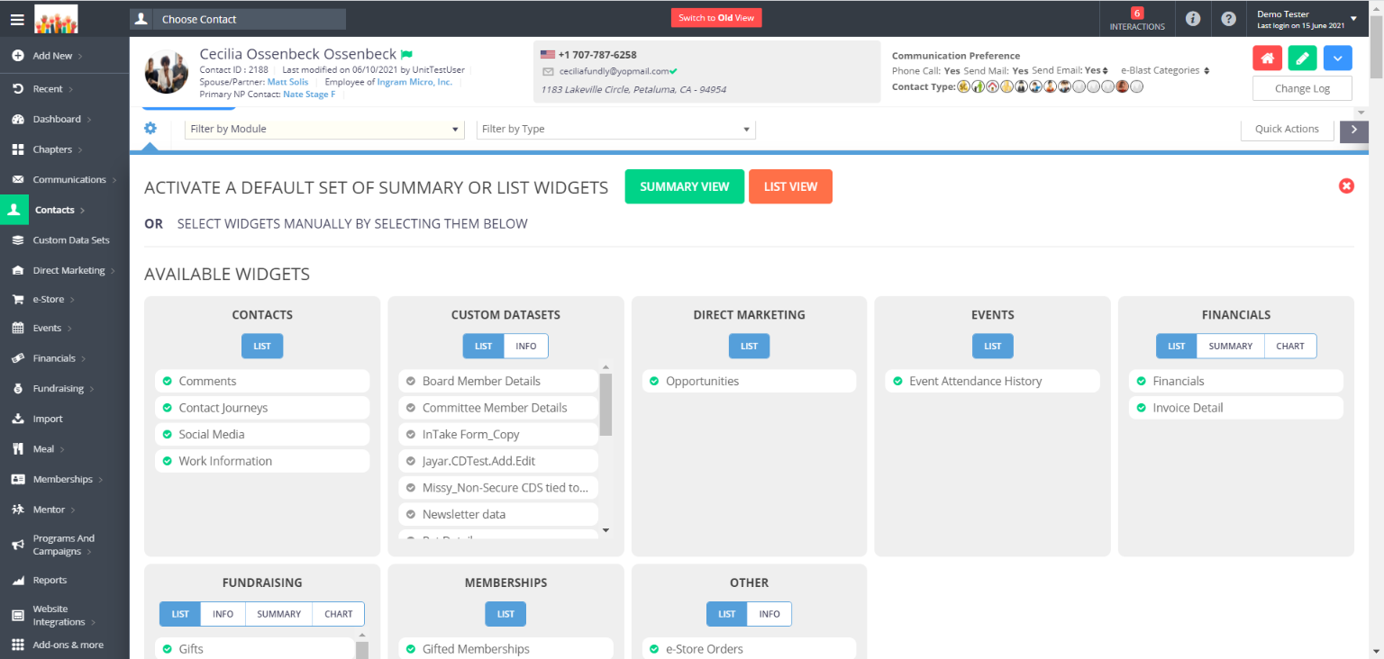
The Available Widgets button allows you to select the widgets you want to display on contact records. Widgets are divided into categories based on content category and widget type.

Slide 9
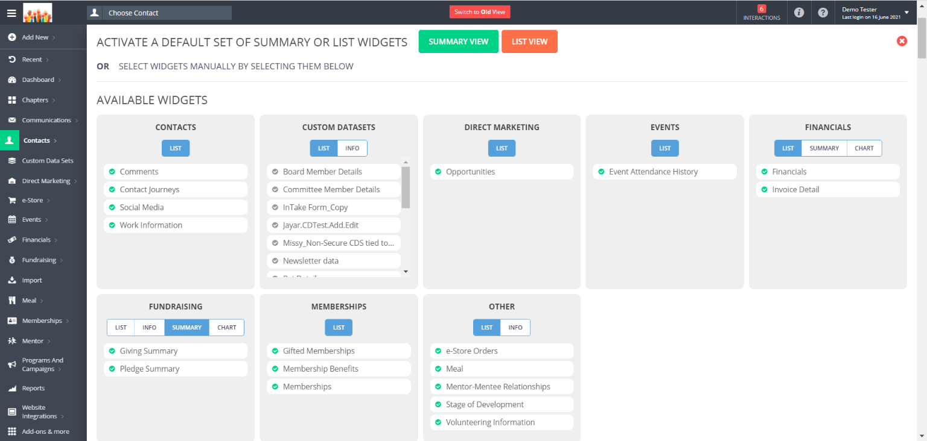
Any changes made here will change the layout for ALL contact records of that type (for example, change the layout for one Individual Contact record and the layout will be changed for ALL individual contact records in your system. Organization and Household contacts will need to be configured separately).

Slide 10
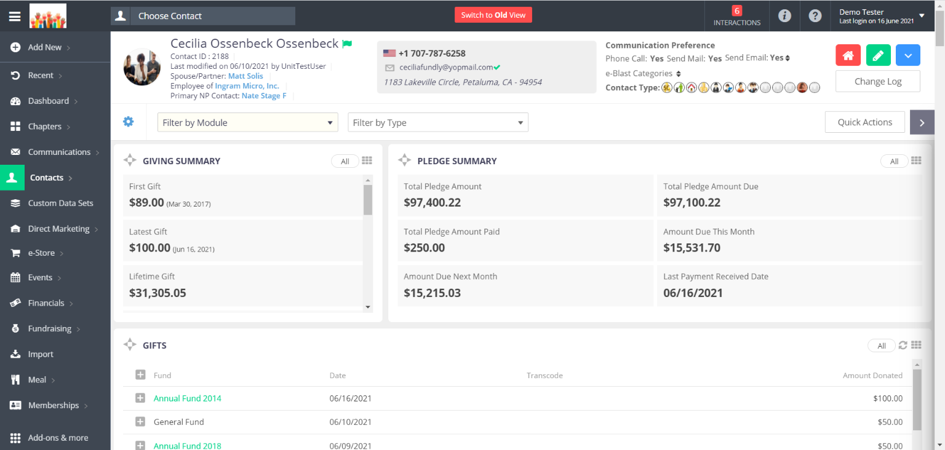
Drag and Drop Widget

Slide 11
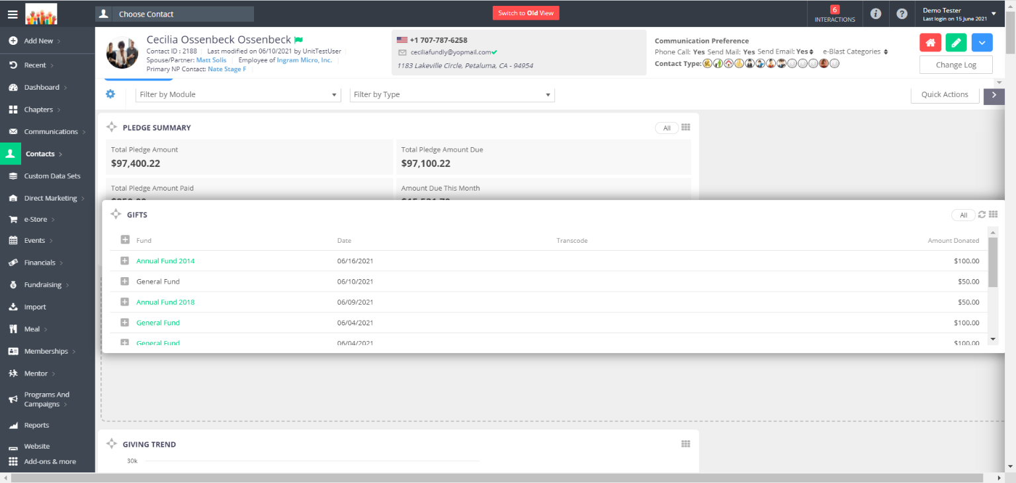
Click on the Star icon on any widget and drag it to move it anywhere on the screen.

Slide 12
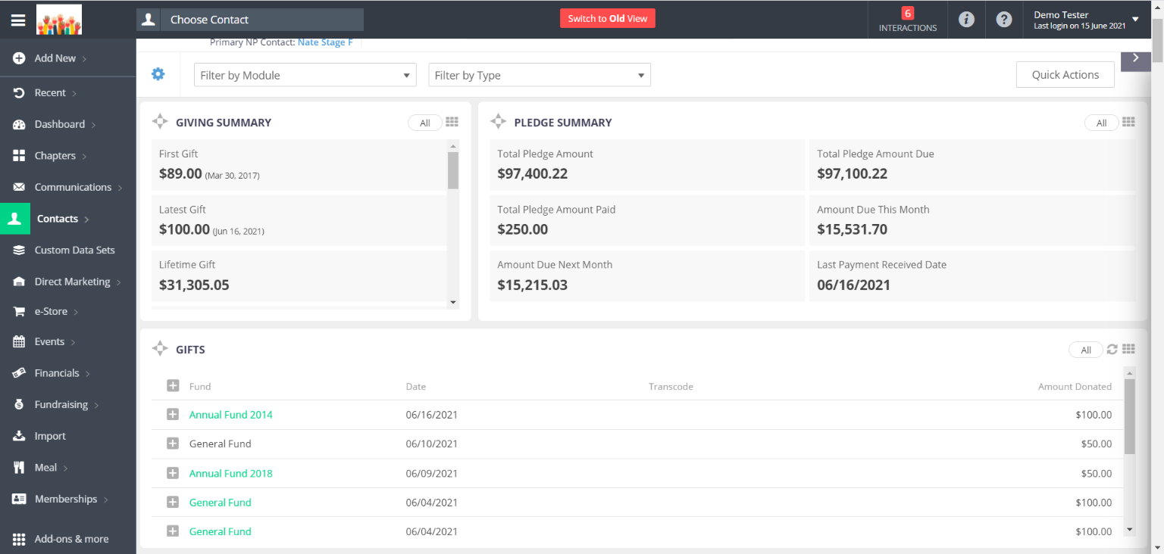
Resizing Widgets

Slide 13
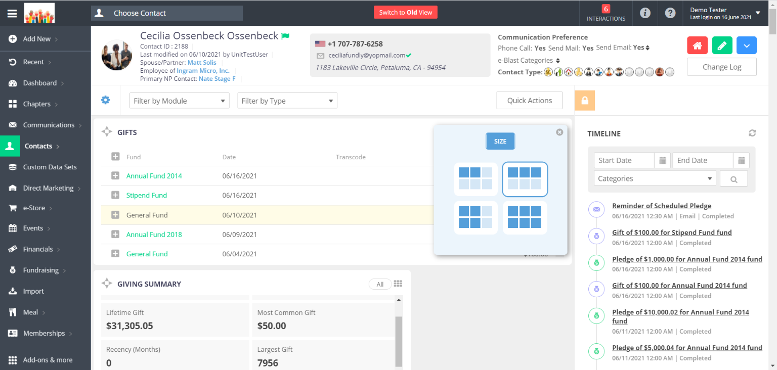
Resize widgets by clicking the 9 dots icon to open the size menu

Slide 14
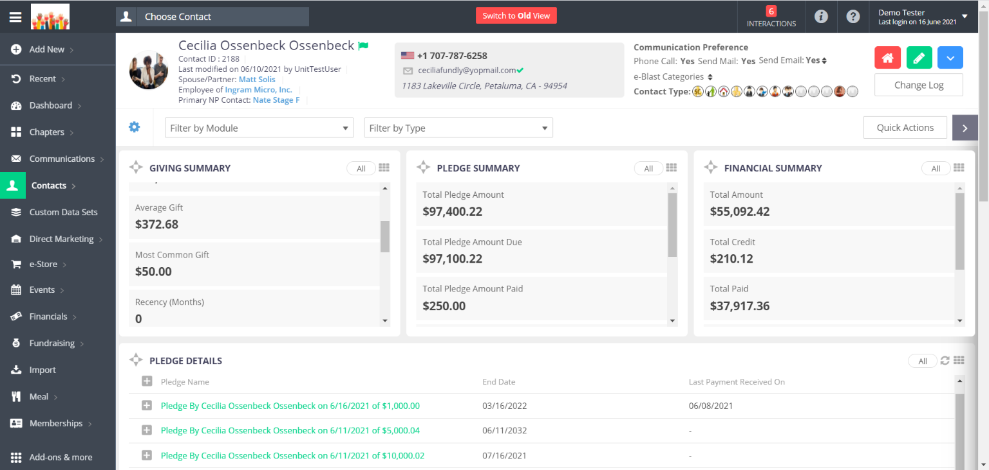
Customize Summary Widgets

Slide 15
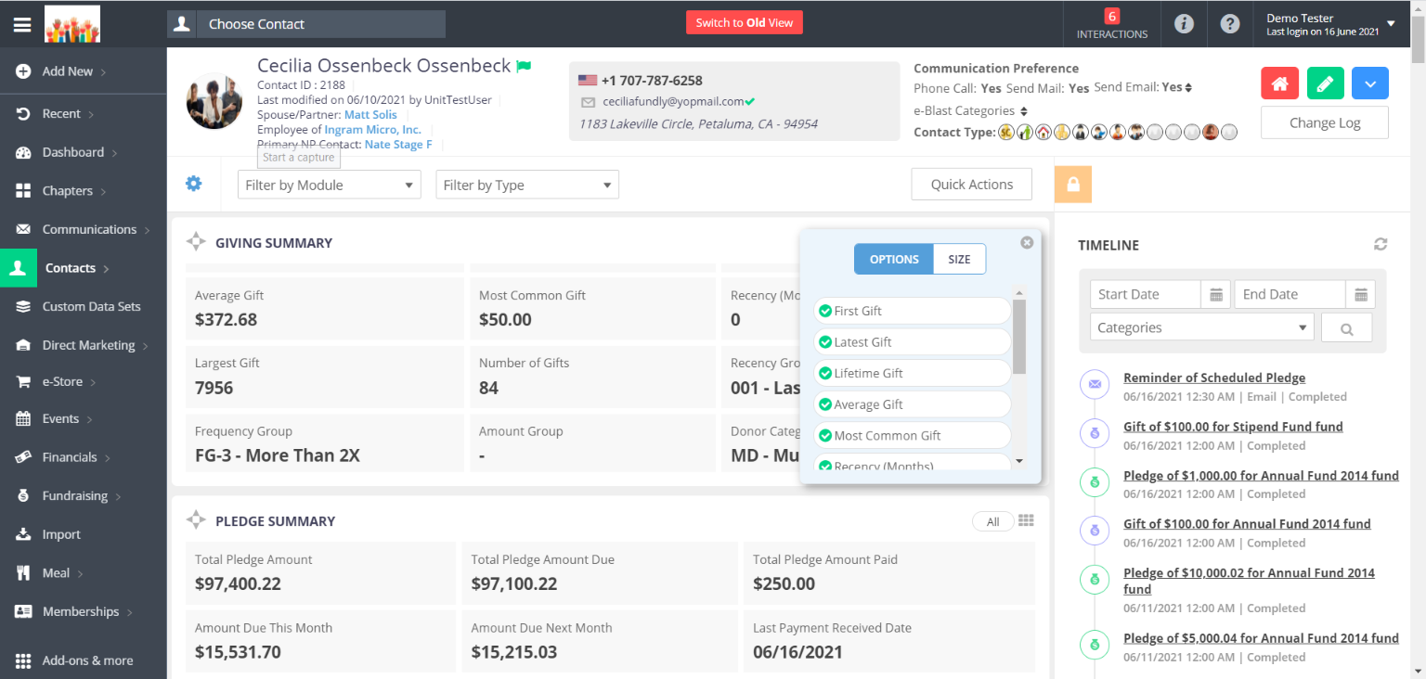
In Summary Widgets, clicking the size/9 dot icon opens a menu with an additional tab for Options.

Slide 16
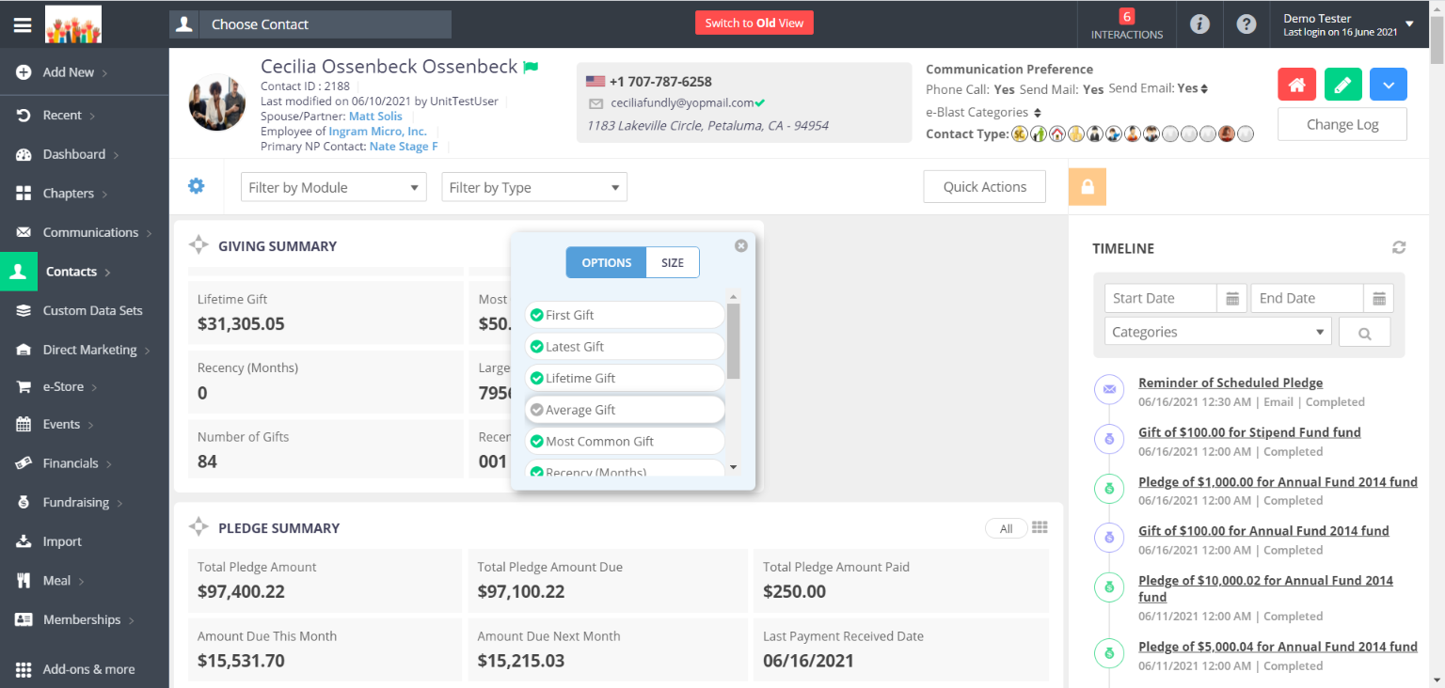
In the Options tab, you can turn on/off individual fields for that widget.

Slide 17
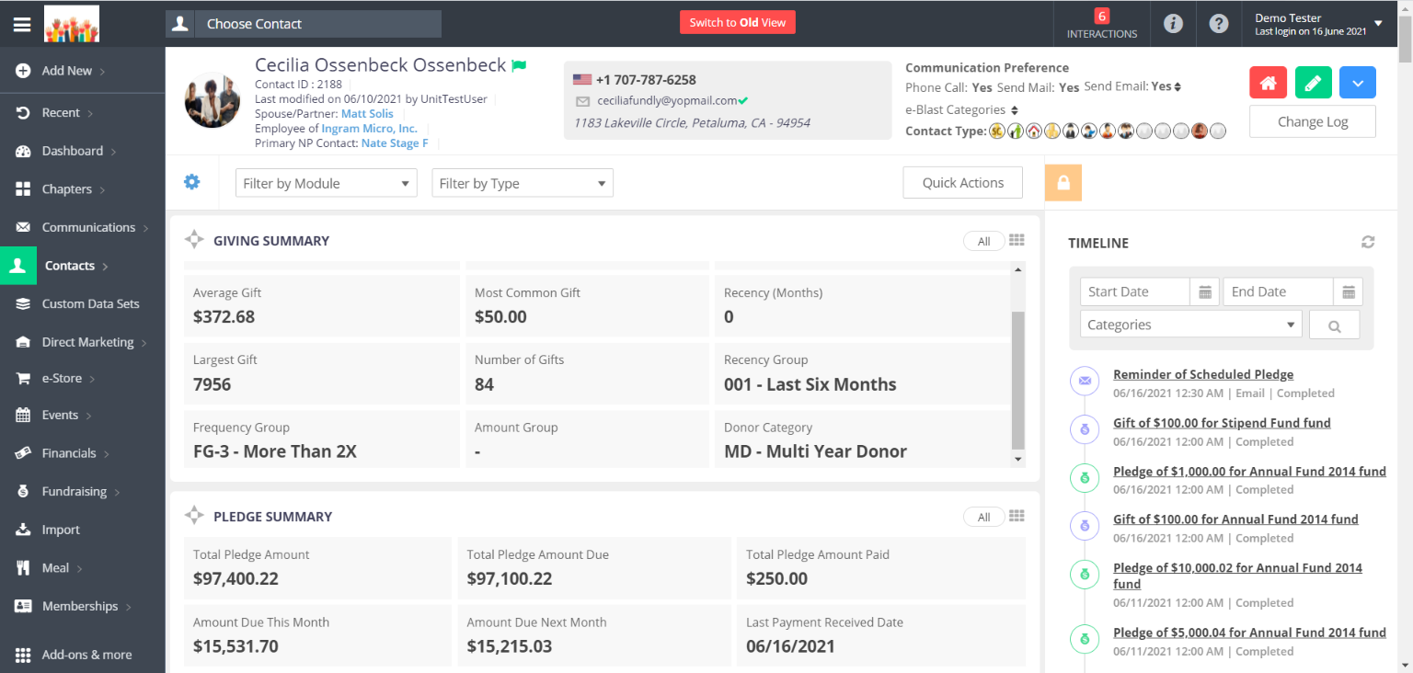
Timeline

Slide 18
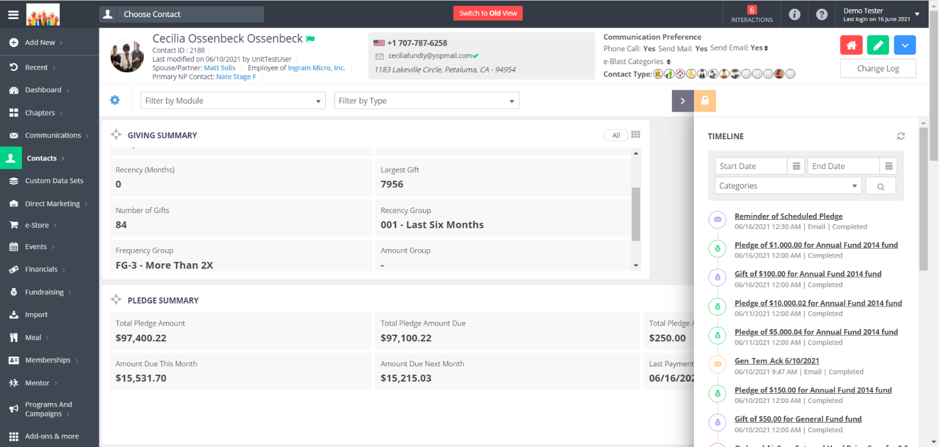
The Timeline shows a roll-up of all activity the contact has had--purchases, communications received, tasks & interactions, etc. The icons on the Timeline entries match the icons on the Main Menu to make identifying transactions by type/module easier. Below the timeline, all Tags and Smart Tags added to the record will be displayed.

Slide 19
Toggle
Lock
The Timeline can be locked in place or can be unlocked (by clicking the lock icon) and then toggled opened/closed.

Slide 20
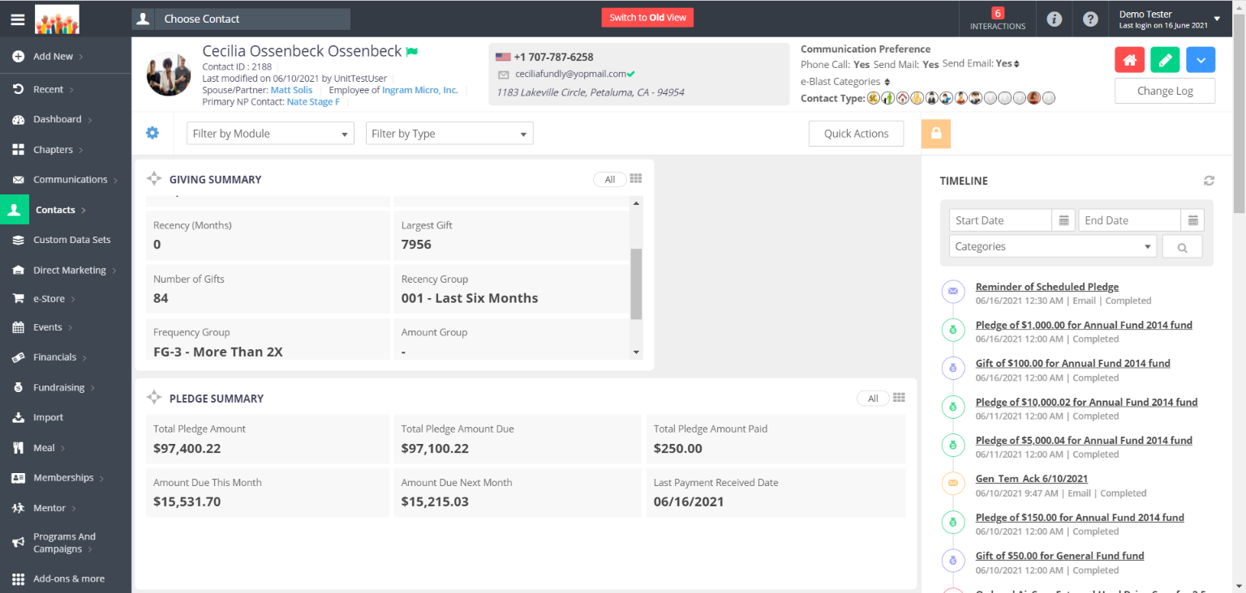
Filter by Module and Filter by Type

Slide 21
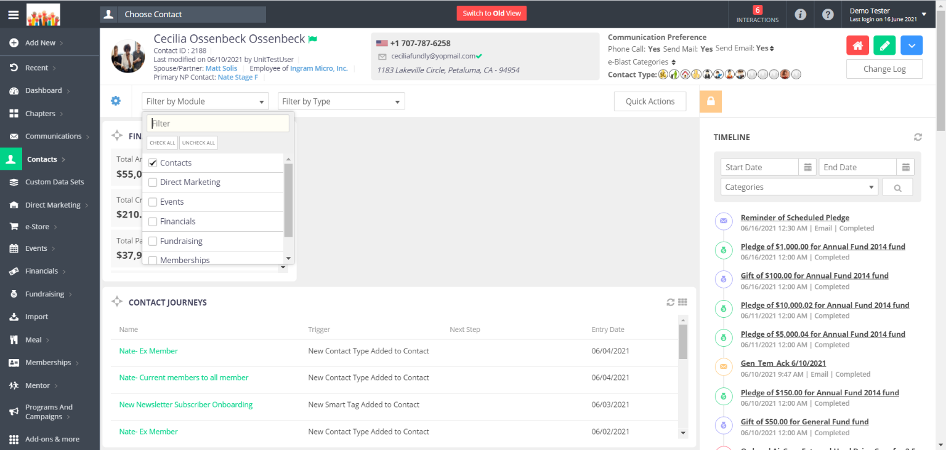
You can quickly filter the widgets showing on a contact record by using the Filter by Module and Filter by Type filters. These are temporary filters that only apply to the contact record you are viewing when you apply the filter.

Slide 22
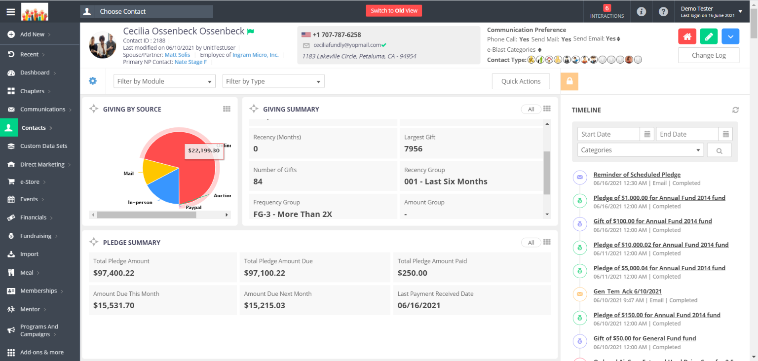
Quick Action Pane

Slide 23
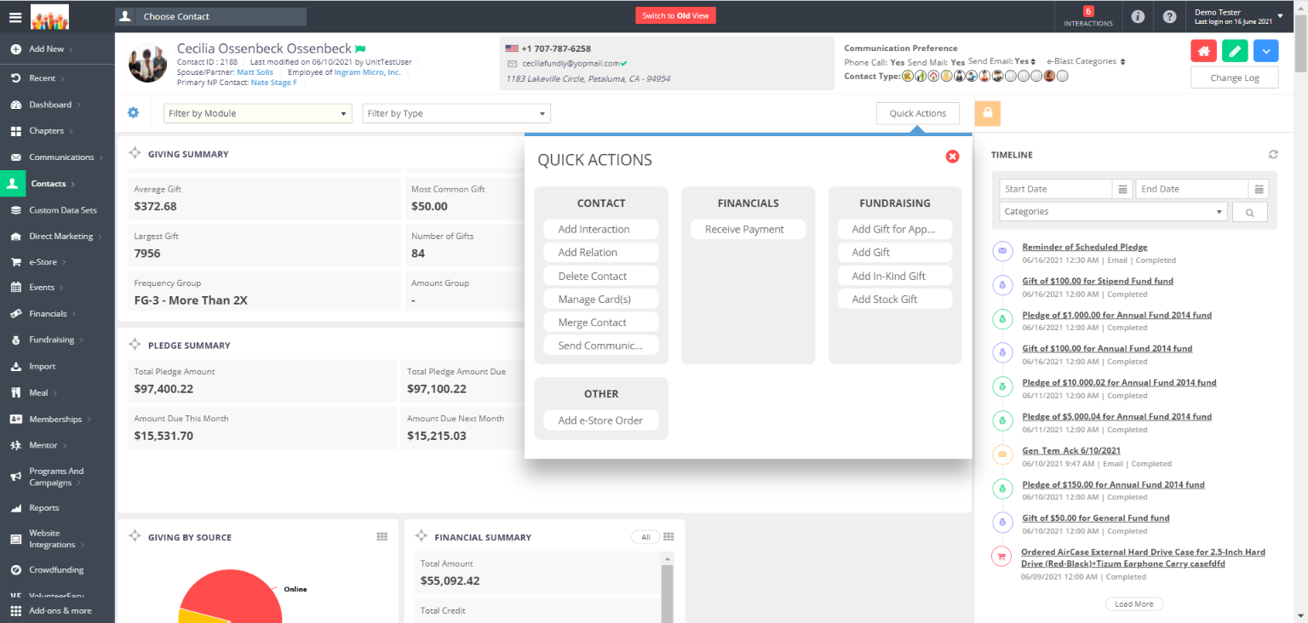
The Quick Action pane allows you to complete common tasks such as updating the contact's default credit card, send the contact a communication, or add a transaction for the contact.

Slide 24
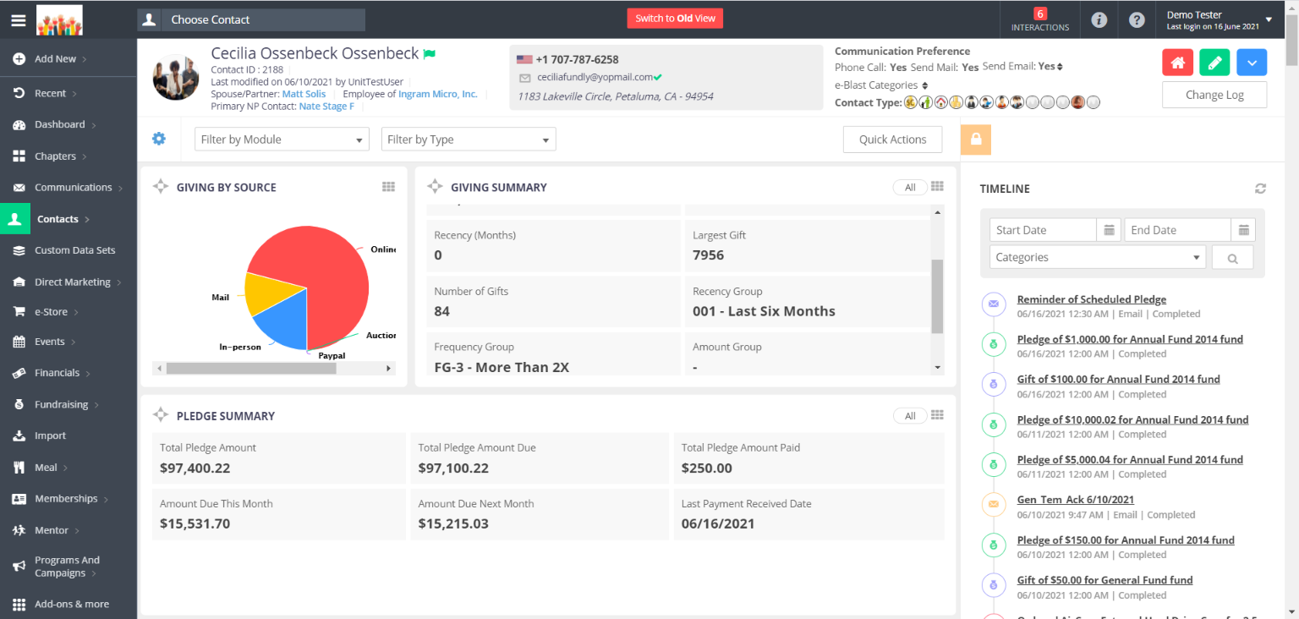
View All and Take Action

Slide 25
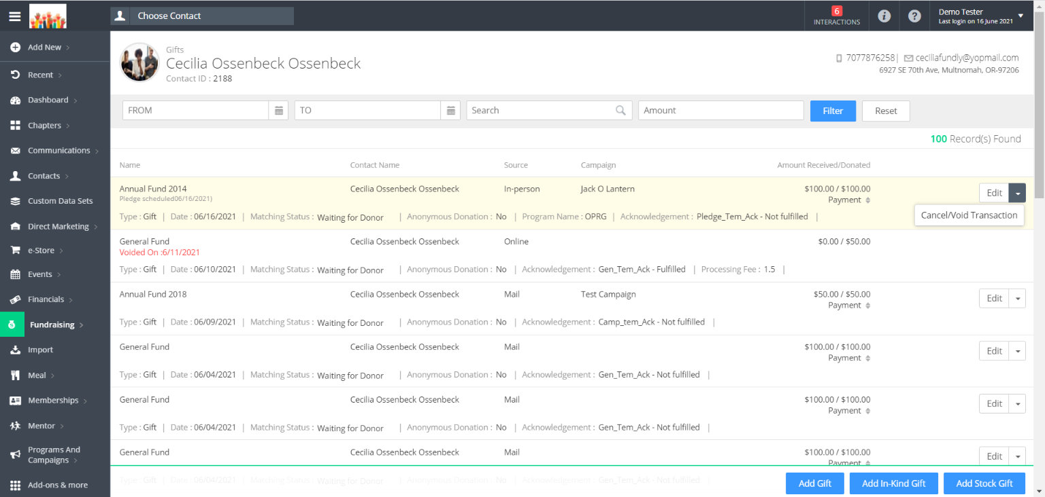
The View All option on List Type widgets will direct you to a new screen with a list of all transactions of that type. From here, you can edit/cancel/void any of those transactions.

Slide 26
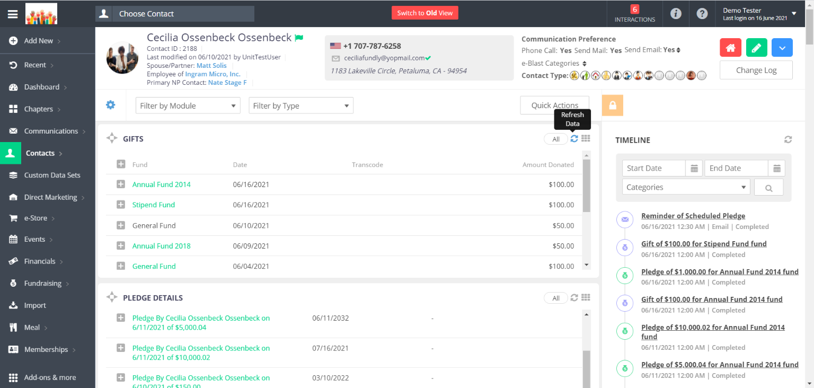
Refresh Data

Slide 27
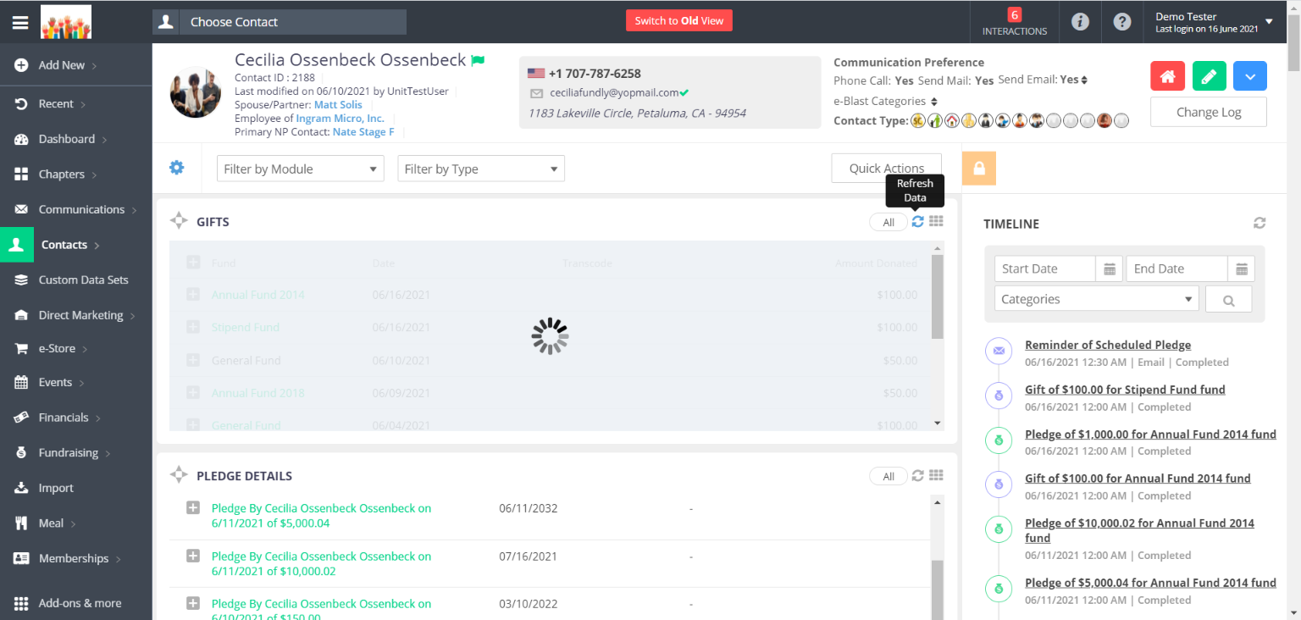
Refresh button will refresh the widget to show the latest data. (Refresh button is not available for the widgets that update overnight).

