Slide 1
Fundly Connect Playbook for Partner Organizations

Slide 2
Setting up for Success.
Welcome to Fundly Connect – YOUR VOLUNTER CENTER NAME’S latest platform for volunteer management. This is an innovative technology that allows your organization to post volunteer opportunities to our public site and better manage your volunteers. As a current partner organization, you will be required to sign in using your _____________ login and temporary password that was sent to your email. Upon login you will have access to a free nonprofit account and can access key tools allowing you to:
1 – Access your database and post your volunteer opportunities to our site
2 – Manage volunteer schedules, log hours, send robust communications
3 – Configure settings and report on volunteer activity
This guide is best used with two screens or printed offline so that you can follow along in the tool on one screen and have this up to navigate

Slide 3
Testing.
If you are a paying Volunteer Center Fundly Connect customer and want to test out Agency account functionality on the Fundly Connect demo site, please signup for an nonprofit organization account at http://fundlyconnectdemo.com/site/acs
*Make sure to “become a partner”
*You will be sent credentials upon signup
*If you’d like to create a volunteer account you can do that as well

Slide 4
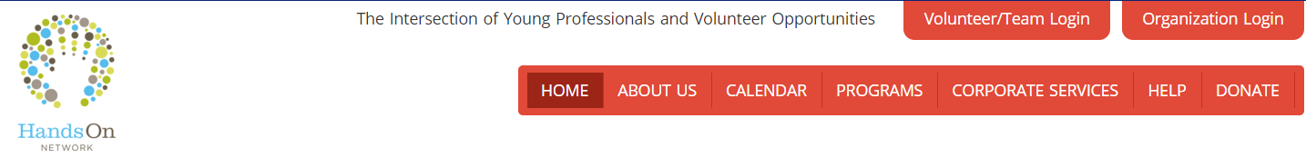
.
Dear Partner Org Name,
HandsOn XXXXXXX has upgraded their volunteer management software to Fundly Connect, chosen by some of the largest volunteer organizations in the world and Points of Light Global Alliance Partner. This change will be effective as of Feb, 2016. As a result, your password has been changed. You will receive an email from Fundly with a temporary password. To access your account, please follow the steps below.
Go to: http://handsonyourcity.org
Click on Organization Login-
Username: Current Username
Password: Temp Password
Once you have logged in, you can change your password by:
Click on your username on the top right hand corner, then click on Account (you may be prompted to login again due to security reasons). Once the Account screen is up, select Credentials-

Slide 5
Connect Playbook
9
Communication
1
2
3
4
Differentiators
Configurations
Basic
Opportunities
Advanced
Opportunities
5
6
7
8
Vol. Management
(Scenario 1)
Vol. Management
(Scenario 2)
Orientations and Trainings
Vol. Management
(Scenario 3)
10
Reports and Support

Slide 6
Differentiators

Slide 7
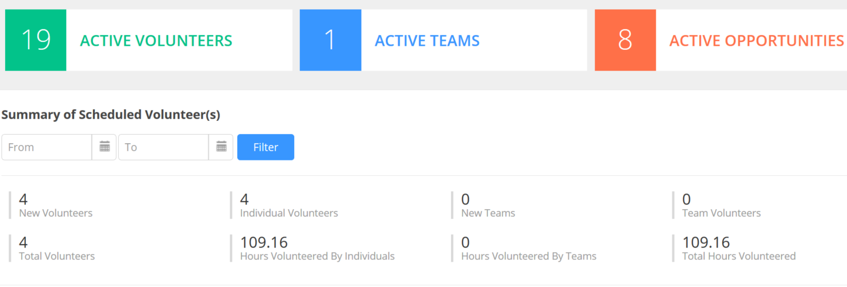

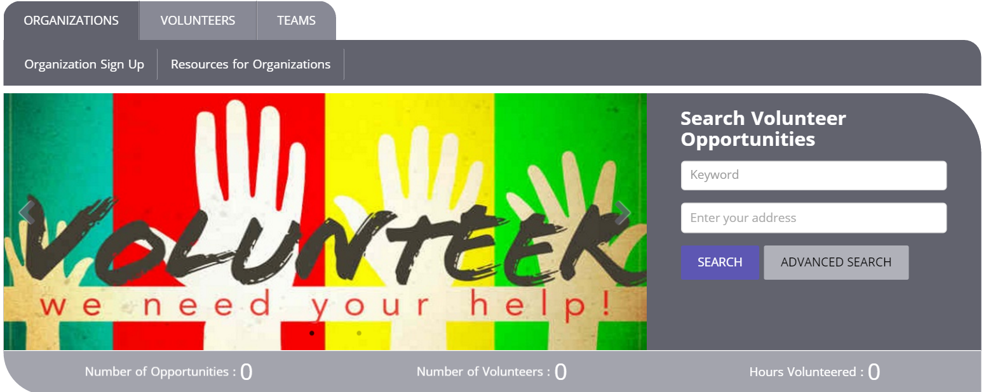
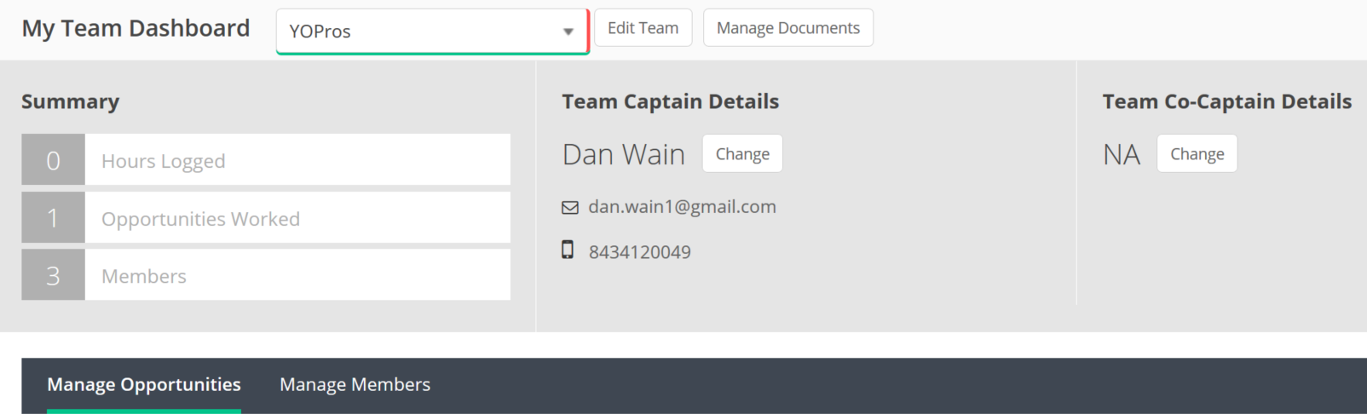
1
DIFFERENTIATORS
Fresh User Interface and navigation. Basic Opportunity and Advanced Opportunity Posting options to your Volunteer Center Portal. A 1-2-3 simple process
Provide your volunteers with a modern dashboard that explains next steps, recommends opportunities, and empowers team and corporate team volunteering
Volunteer Center can provide you with a “Search Widget” to put on your web site which shows your logo and all volunteer opportunities
A full communications module with beautiful templates you can edit to send to your volunteers AND metrics showing opens, clicks, bounces and more
Quick Add volunteers to your database and flip between calendar or list view to log hours and manage attendance
Integrate Fundly Connect with Fundly CRM and reap the benefits of Fundly’s Crowdfunding Platform
Notes:
In this slide there is a background placeholder. Click to the small icon on the center of the slide and choose an image from computer. When add an image, you must sent it to back with Right Click on Image -> Send to Back -> Send to Back.

Slide 8

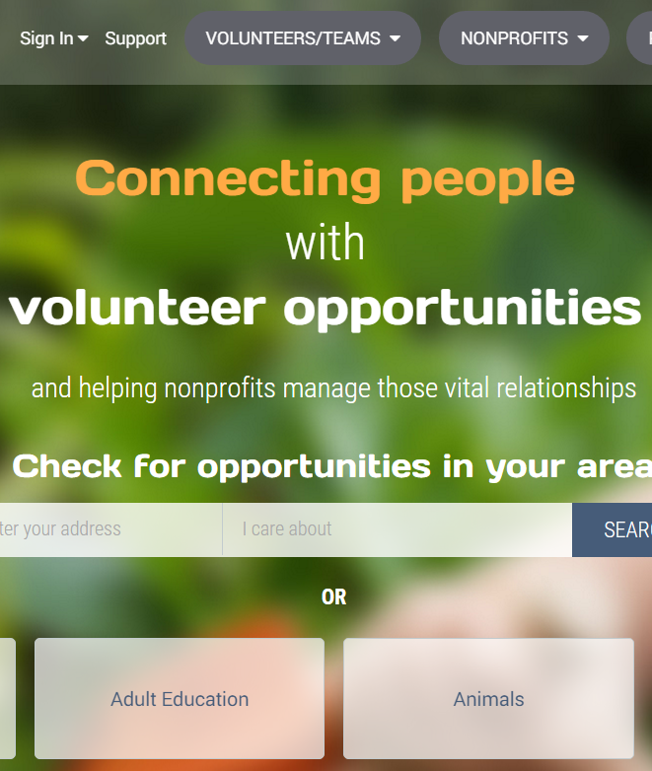

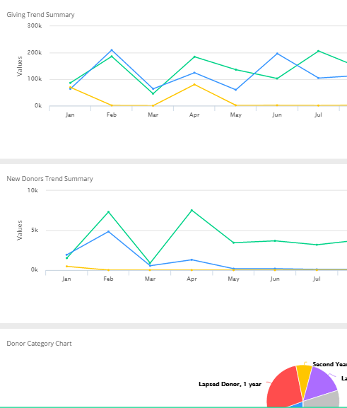
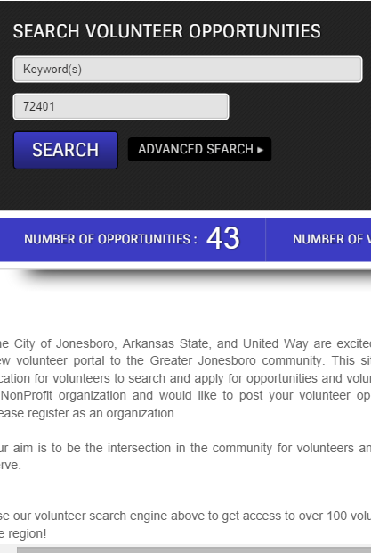

1
Responsive Design
Meet the demands of your volunteers and corporate relationships
Design
Agnostic
Access
All products in the Fundly suite are mobile responsive meaning your donors and volunteers can access the info they need from the device of their choice
The platform can be accessed via any internet browser. Each product is cloud based so team members can retrieve and enter data from home, in the office, or on the road
With over half of a nonprofits volunteers and donors likely visiting the organization through a mobile device, you can’t afford to have a misaligned user experience
A Growing Trend
50%
50% of ecommerce traffic occurs through a mobile device (40% smart phone, 10% tablet)
Having a mobile-ready toolbox is crucial for managing relationships and administering fundraising campaigns, volunteer programs, and running a nonprofit optimally. As fundraising professionals and volunteer leaders are often out of office and more and more relationships are developed on the fly, being able to provide a mobile experience facilitates better engagement, easier volunteer management capabilities, and a sound data management strategy.

Slide 9
Configurations and General

Slide 10
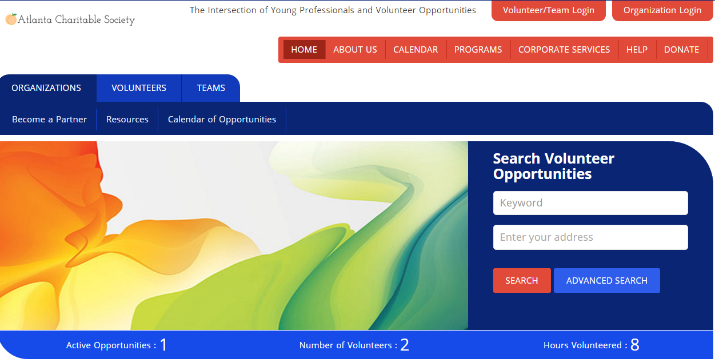
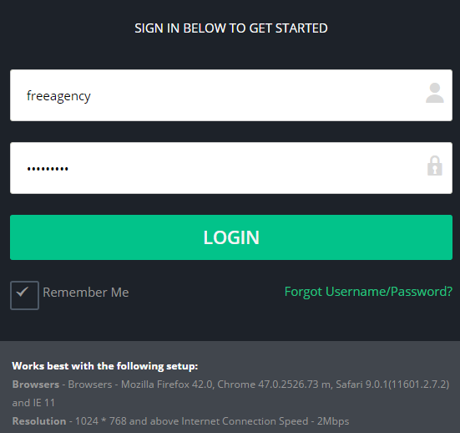
2
Logging In
1. Start by clicking
2. Sign in using your current username and temp. password
f

Slide 11


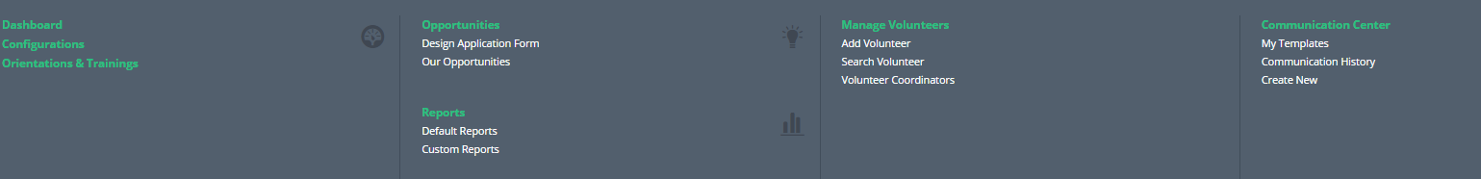

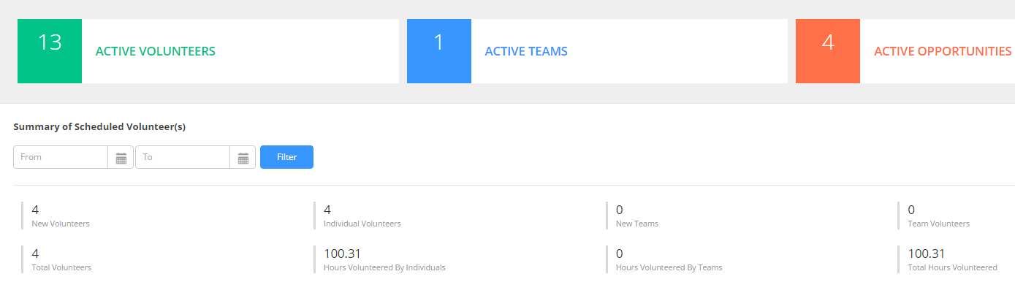
2
Dashboard Overview
By clicking on one of the color coded blocks, you are taken to a list representing your selection
Try adding a few volunteers to your account manually
Your dashboard metrics update when:
New opportunities are activated by you
Volunteers or teams apply to your opportunities
Hours are logged for a volunteer

Slide 12


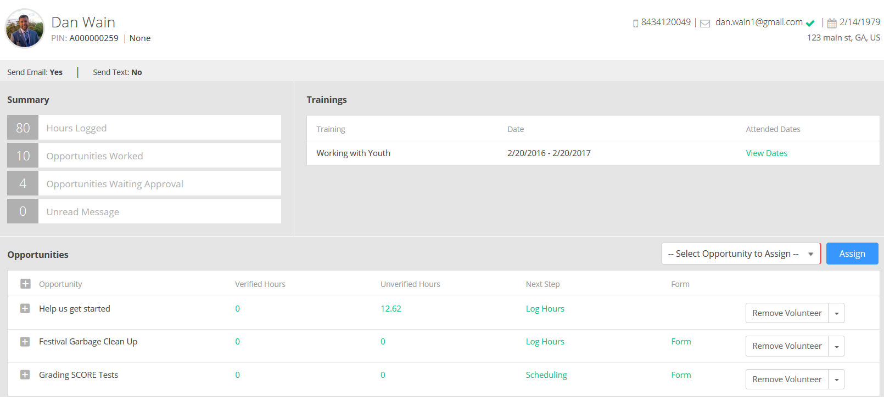
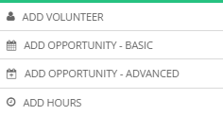

2
Volunteer Profile
From the volunteer profile you can also do a number of tasks such as assign them to an opportunity, edit schedules, view training dates, log hours, and review skills and causes they are passionate about
General demographic information and custom data sets also live here
If you need to change any information on the volunteer, select Edit Volunteer
A volunteer will fill out much of the demographic and interests information upon signup online, but you can also add volunteers offline and send them an account setup link so they can login to Fundly Connect (recommended)

Slide 13


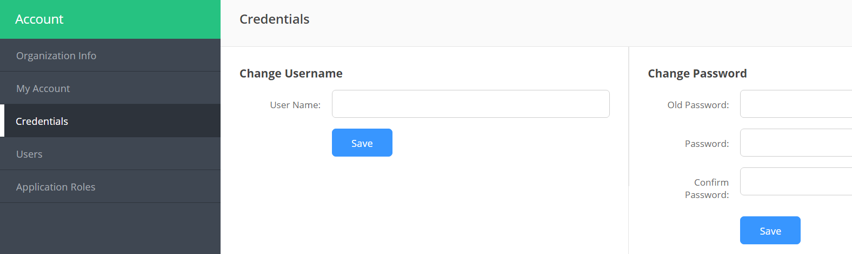





2
1. Click
My Account
2. Click
and change PW
3. Click fill out your
organizations information
(upload your logo)
4. Click
(more on next page)
5. Click to create
new ones (email sent)
Will always take you back into your dashboard

Slide 14
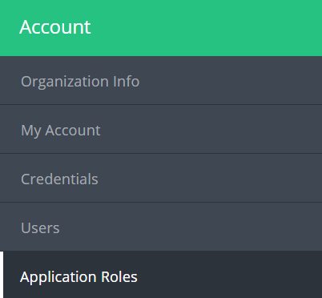
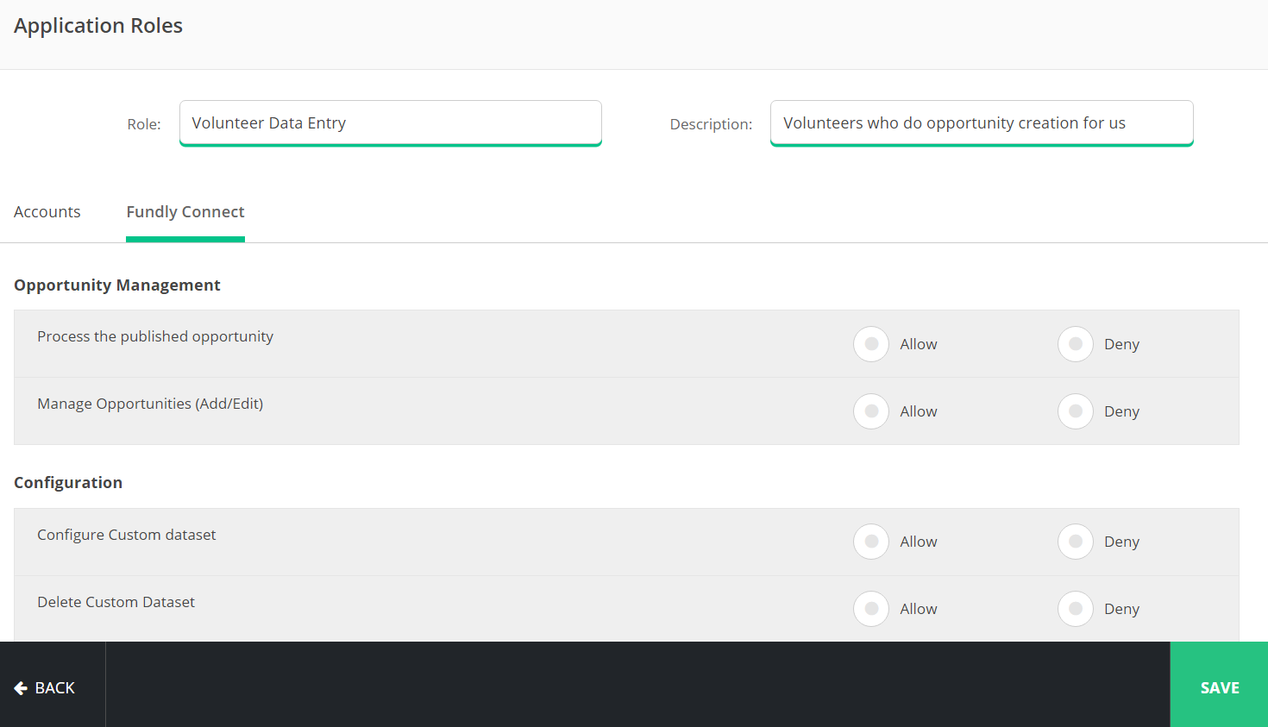


2
Application/User Roles
*Roles allow you to Allow/Deny specific volunteer management functions for users in Fundly Connect
*When you create a new user, you need to assign them a role. In this example I am creating a limited role for a volunteer
*Click for your dash

Slide 15
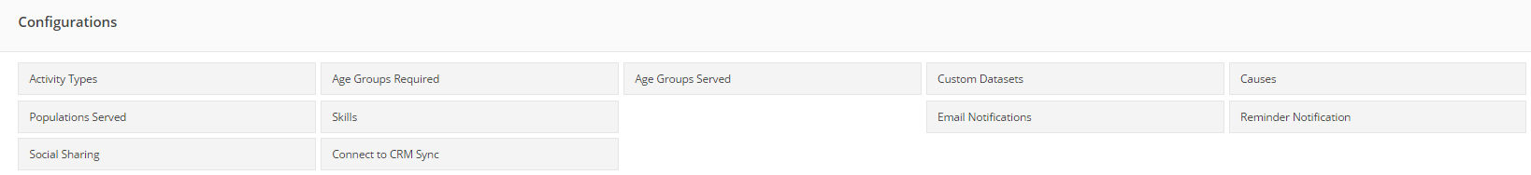
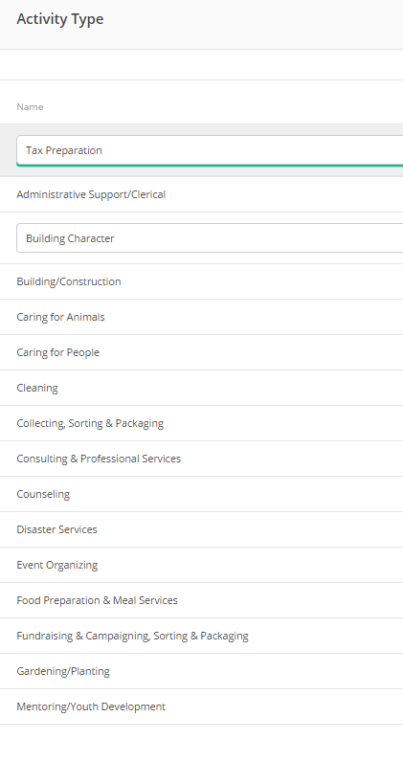
2
Basic Configurations – Activity Types, Age Groups, Causes, Populations, Skills
Click and select
Basic Configurations in Fundly Connect are simple field entries you make to add to existing options that are system wide. You can add but not delete fields so try adding some that are relevant to what your focus areas are.
These entries allow you to categorize your volunteer opportunities so potential volunteers can whittle down the ones that interest them when searching on the volunteer center’s public site.
These Configurations involve adding your additional fields (if desired): Activity Type, Age Groups Required/Served, Causes, Populations Served, Skills

Slide 16
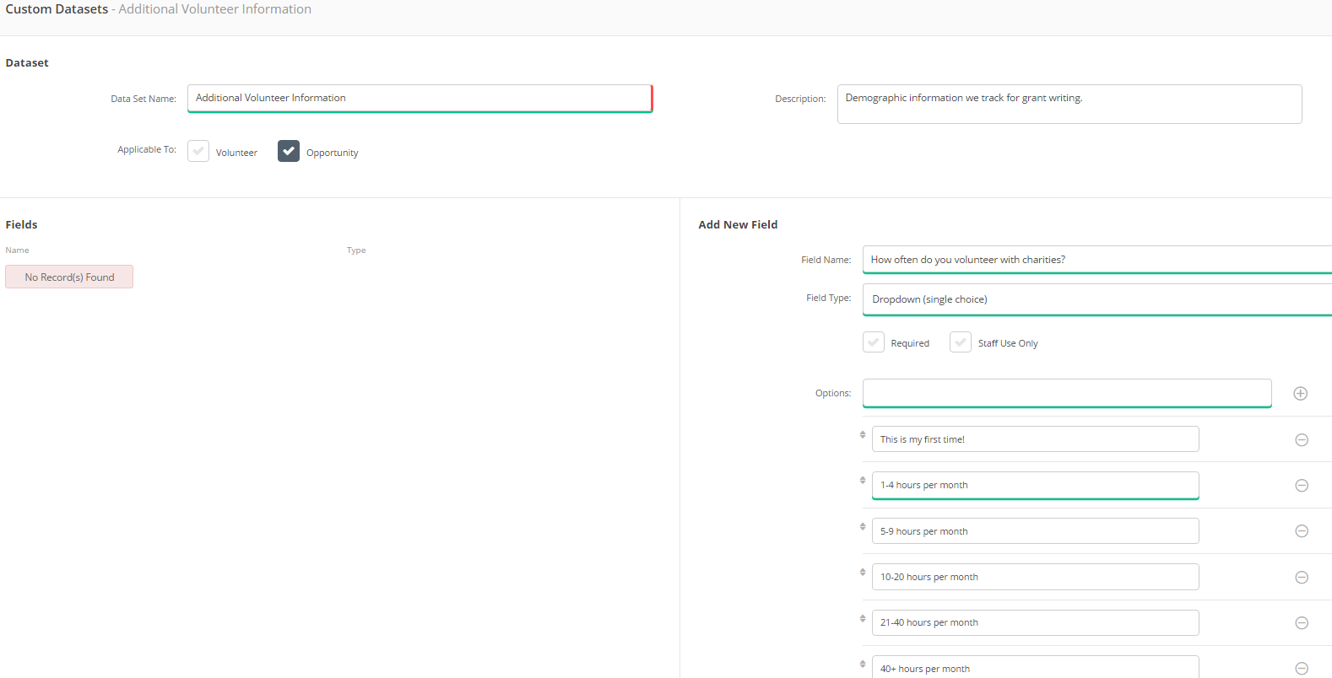


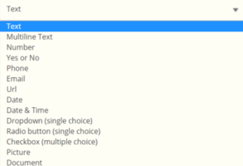
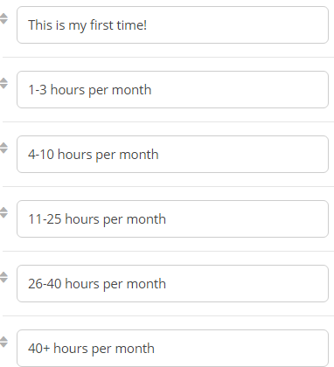
2
Configurations – Custom Data Sets [Opportunity Level]
A custom data set at the
level allows you to create questions
on your Opportunity Signup Forms
In the example, we have created a Dataset called
and a field type of
Determine whether or not you want this to be a required or optional question on your signup form
You can add more than one question/field and field type to a data set
Create your dropdown options to the question and
Field Type Options

Slide 17
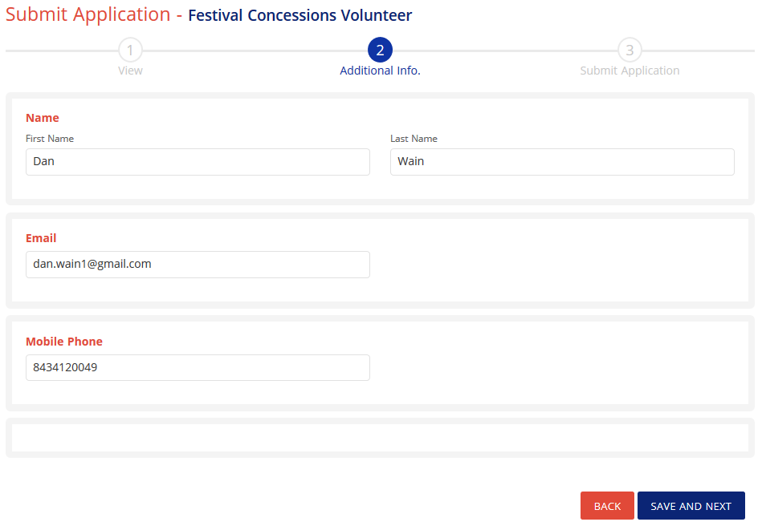
2
Configurations – Custom Data Sets [Opportunity Level Example]
This is an example of an online application form a volunteer might fill out on the Volunteer Center site to apply to your opportunity
Your dataset appears on the form with dropdown options you’ve input
See Page 19 for more info on Application Forms
Custom data set: “How often do you volunteer with charities?”

Slide 18
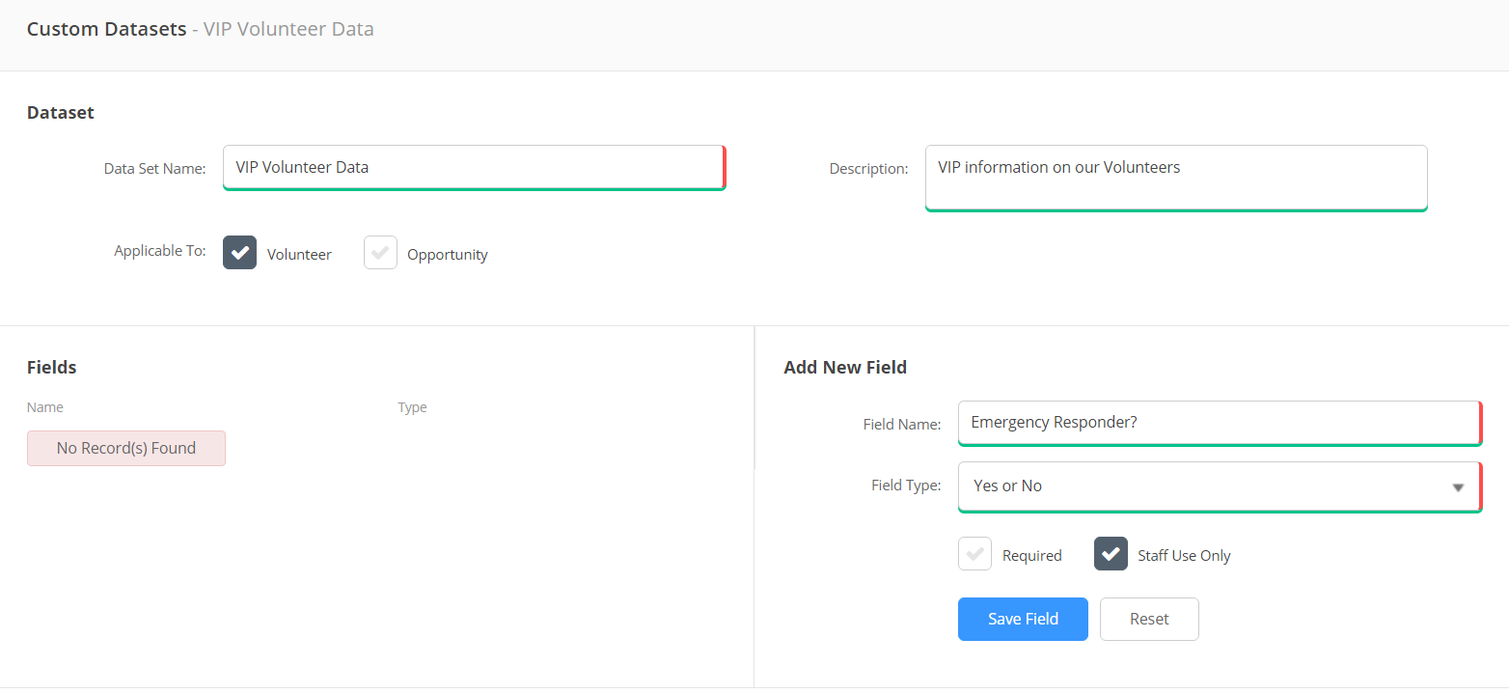




2
Configurations – Custom Data Sets [Volunteer Level]
A custom data set at the
level allows you to track questions
and data fields on volunteers in the
“back office” in volunteer records
In this example we have created a Dataset called and a field type of
If you select the dataset will only be available for your staff to fill out on volunteer records when editing volunteers in Fundly Connect
Go ahead and create a few fields for this data set. Make sure to save your fields

Slide 19
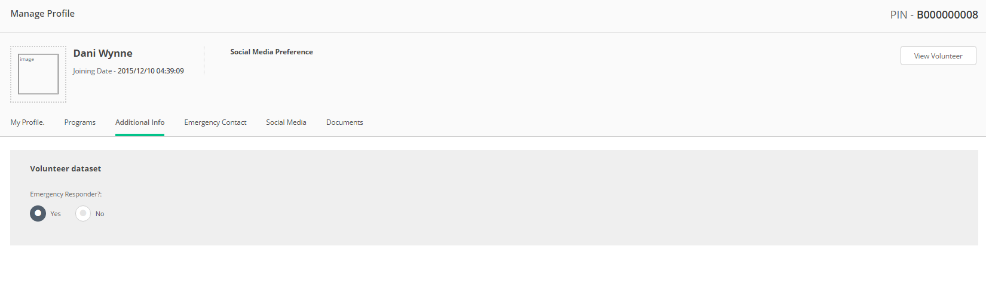


2
Configurations – Custom Data Sets [Volunteer Level Example]
An example showing your Volunteer Custom Dataset while editing a volunteer record in “Additional Info”

Slide 20
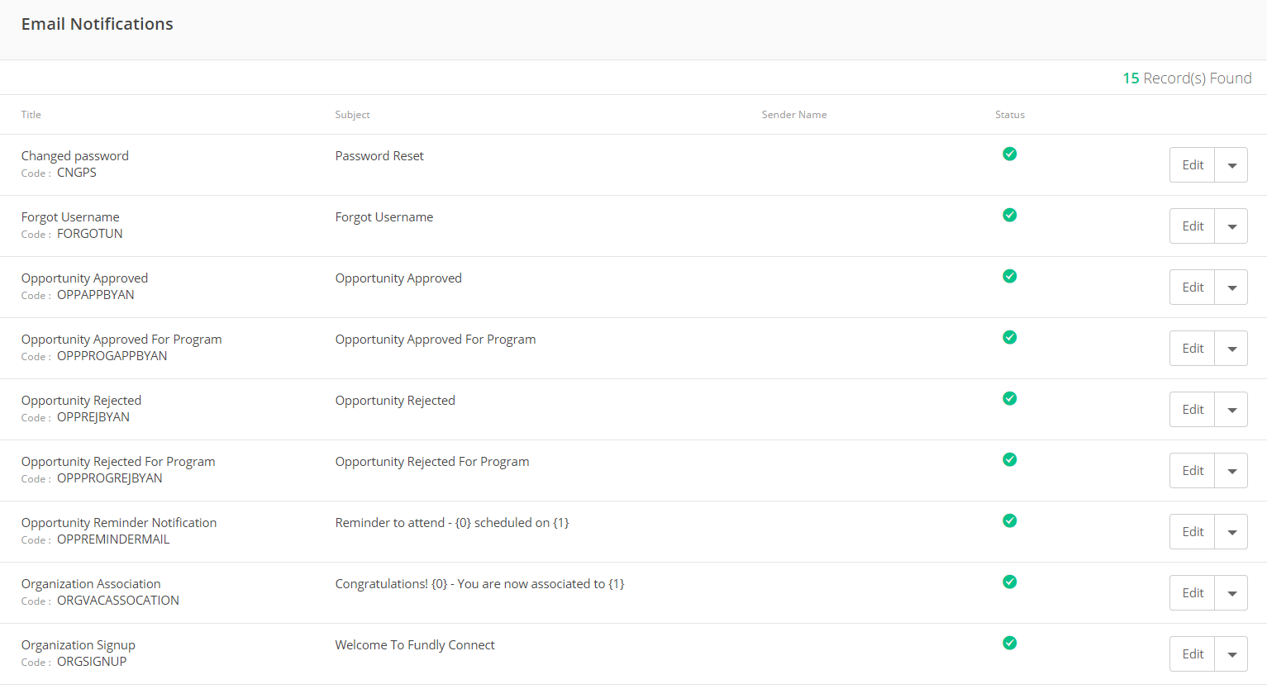
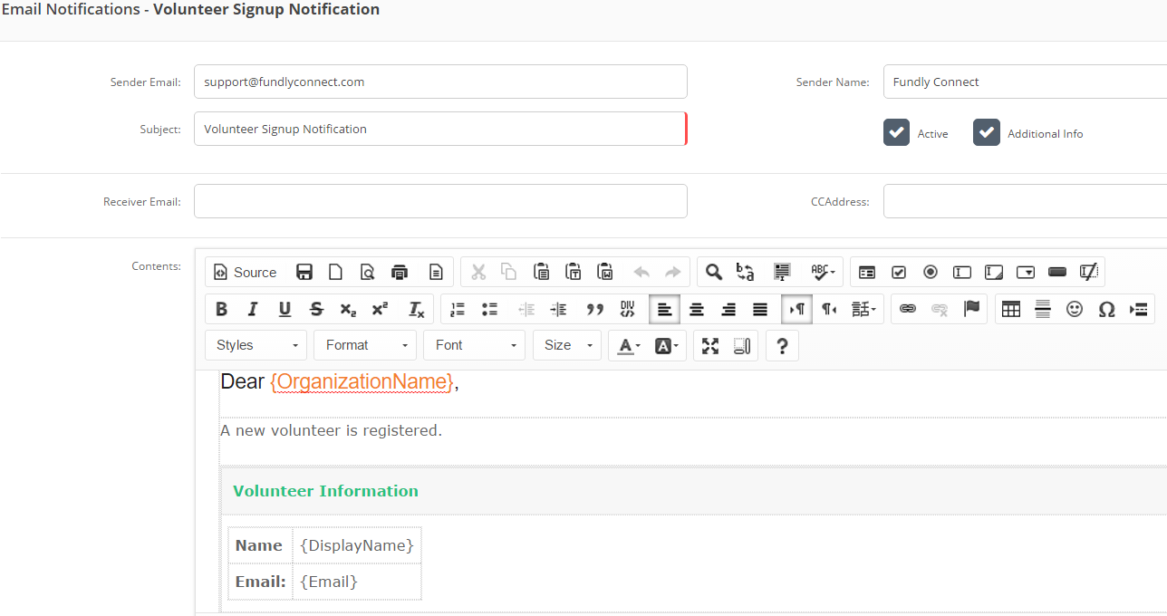
2
Advanced Configurations – Email Notifications
Email Notifications are system generated messages that are triggered when a volunteer takes action, your volunteer opportunities are approved by the volunteer center, a team signs up, a password is reset and more.
Feel free to use the editing tools in Email Notifications and create your own messaging. The fields in brackets are system generated so do not try and edit those unless you want to remove them.
If you want to cc someone or set a receiver email to get these notifications, insert their email into receiver email or cc email

Slide 21
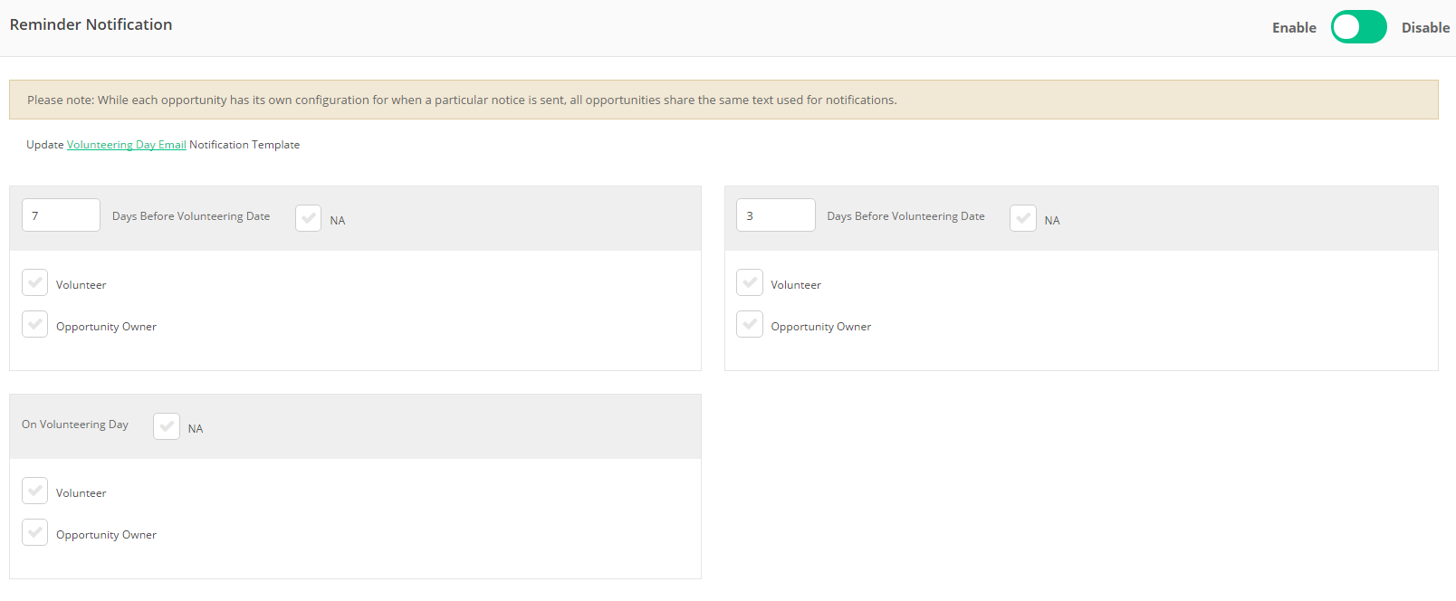

2
Advanced Configurations – Reminder Notifications
Email Reminder Notifications are also system generated reminders that are sent to volunteers for upcoming volunteer opportunities
You can set two notifications for when you would like these reminders to be sent (days before) to your volunteers and then once on the Volunteering Day.
Select to send the message reminder to both the volunteer opportunity owner and the volunteer
Edit your reminder message by clicking:

Slide 22
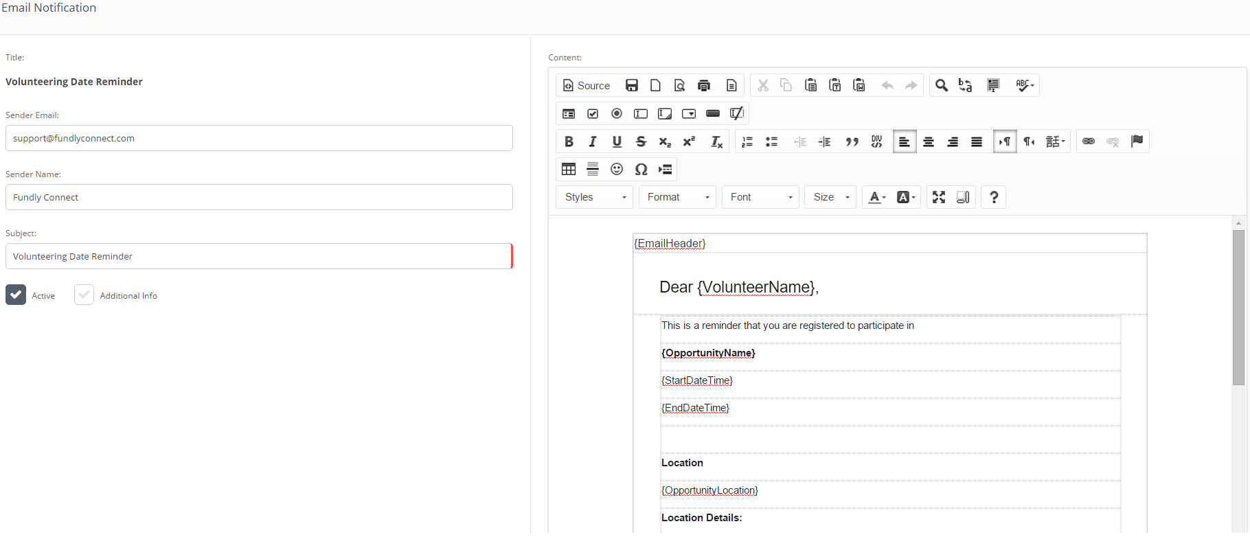
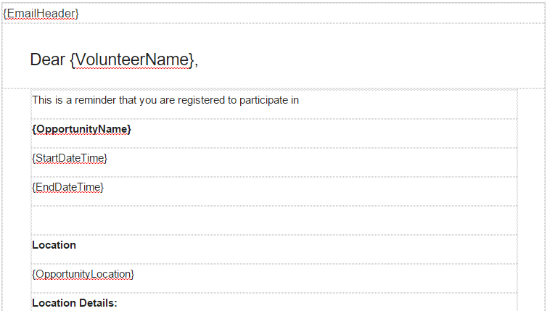
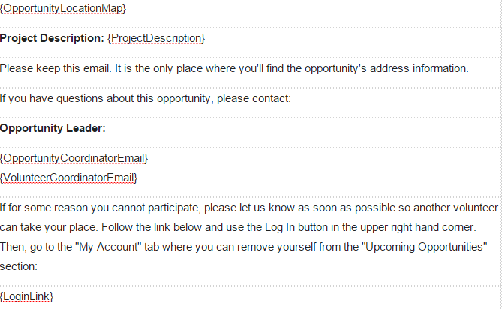
2
Advanced Configurations – Reminder Notifications
You may edit the reminder notification that is sent to your volunteers here
Changing the Sender Email will allow you to input your organization email if you’d like
The message is templated where brackets exist so do not edit those unless you want the system fields removed. These are fields in the system that pull from database tables so the message can accurately fill in the Volunteer and Opportunity details

Slide 23
Basic Opportunities

Slide 24
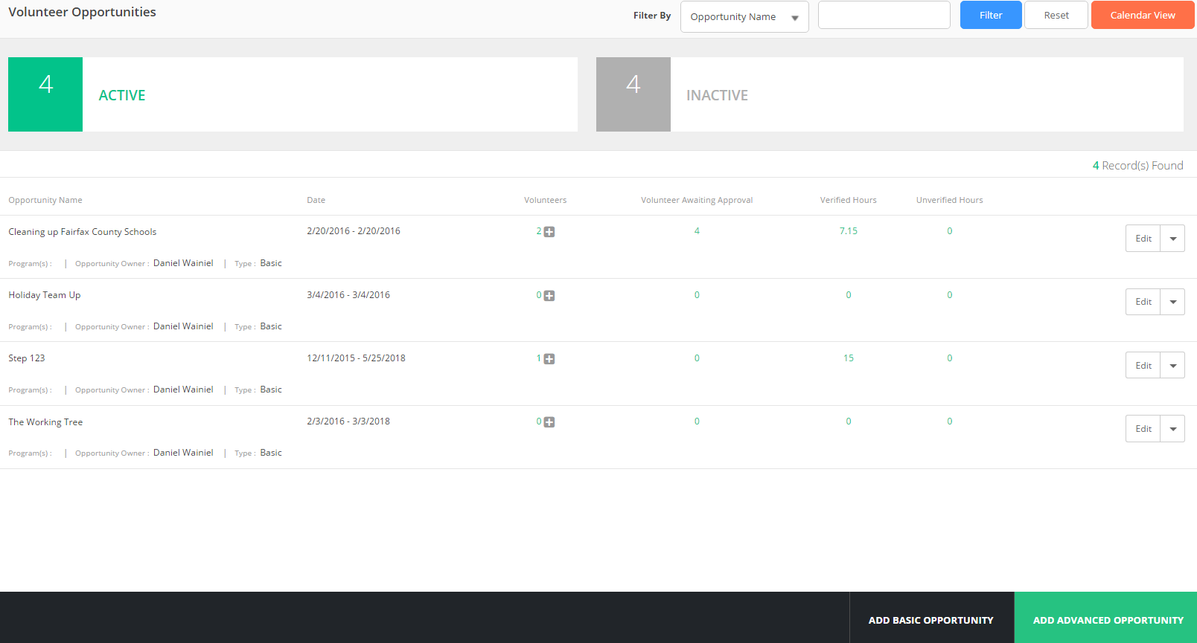

3
Volunteer Opportunities– Basic Opportunities
Navigate to
Your Opportunity Dashboard will highlight active opportunities and also bucket your inactive/past opportunities
From this screen you can:
- edit an existing opportunity details
- add volunteers to an opportunity
- approve volunteers if approval is
required
- open a calendar view and filter
We will review the aforementioned features later

Slide 25
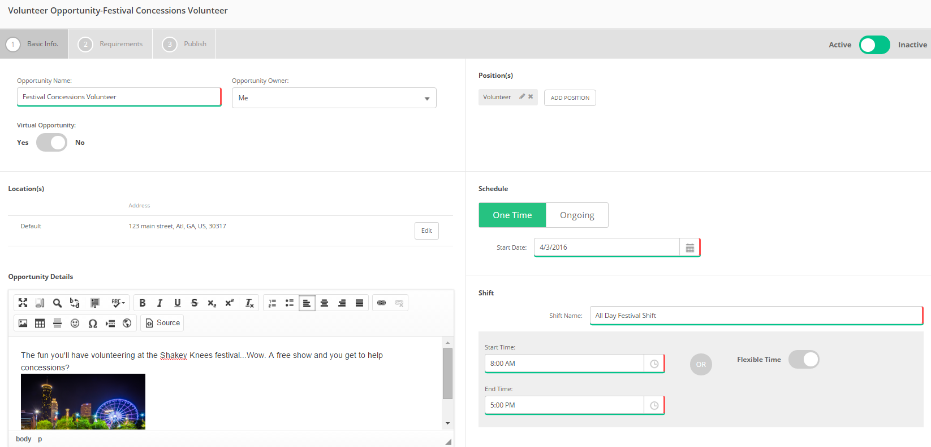
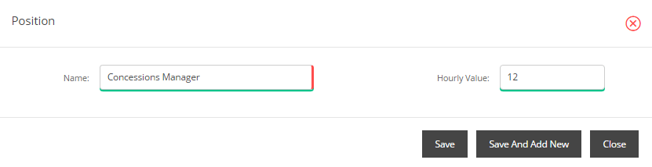

3
Basic Volunteer Opportunities – Basic Info
Fill out your opportunity name, location, details about the opportunity, and schedule
You can input pictures and content in the Opportunity Details to make the opportunity come alive
Create multiple Positions for opportunities
Tip: associate an hourly value to positions for reporting purposes to track $ impact
A Basic Opportunity includes basic scheduling: One-time or Ongoing Opportunities and single location
A Basic Opportunity includes one shift (ex: Morning, Afternoon, All Day)

Slide 26
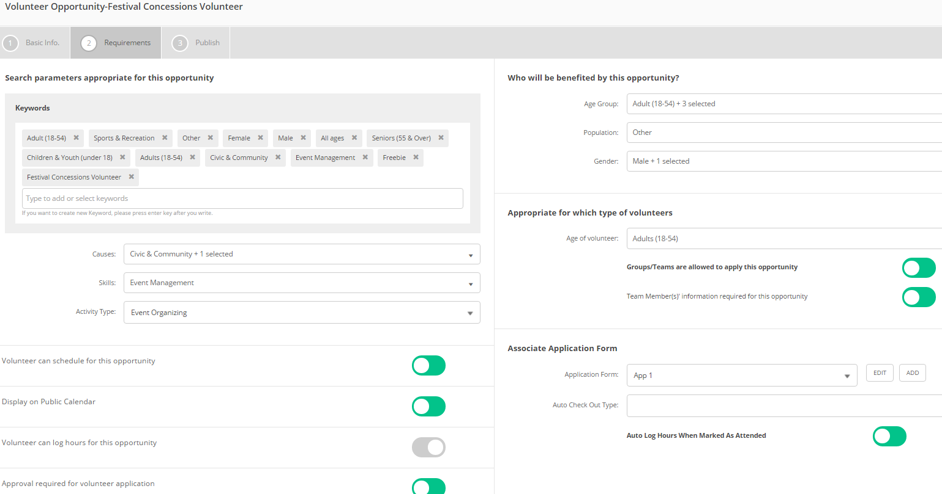

3
Basic Volunteer Opportunities– Requirements
Type in some keywords for your opportunity. Other keywords will automatically be added based on your opportunity title and settings
Associate a Cause, Skills, and Activity Type to the opportunity
Define ‘Who Benefits’ and what age range should apply
Toggle on/off if teams can apply and whether or not you need their Name, Email, Phone details upon signup
Always toggle Display on Public Calendar if you want the opportunity to post to the Volunteer Center Portal

Slide 27
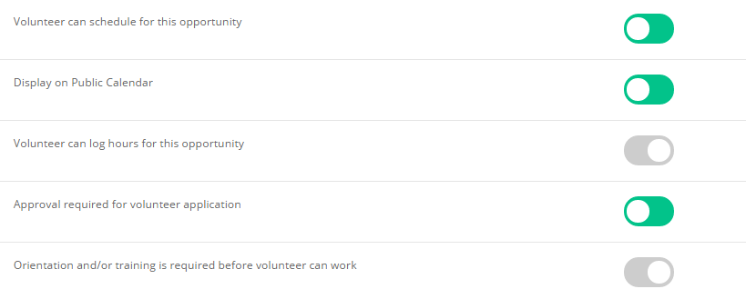
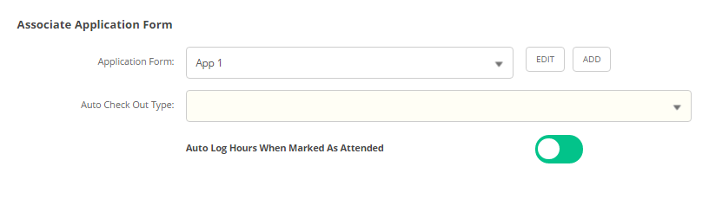
3
Basic Volunteer Opportunities– Requirements
Volunteer can schedule for this opportunity allows a volunteer to confirm the dates/shifts/positions they want to volunteer
Volunteer can log hours for this opportunity allows a volunteer to input their own time volunteered
Approval Required for volunteer application means your organization must review and approve the volunteers application before they can volunteer
Orientation/Training Required means the volunteer must have been marked as attended to a training session before scheduling that volunteer for the opportunity

Slide 28
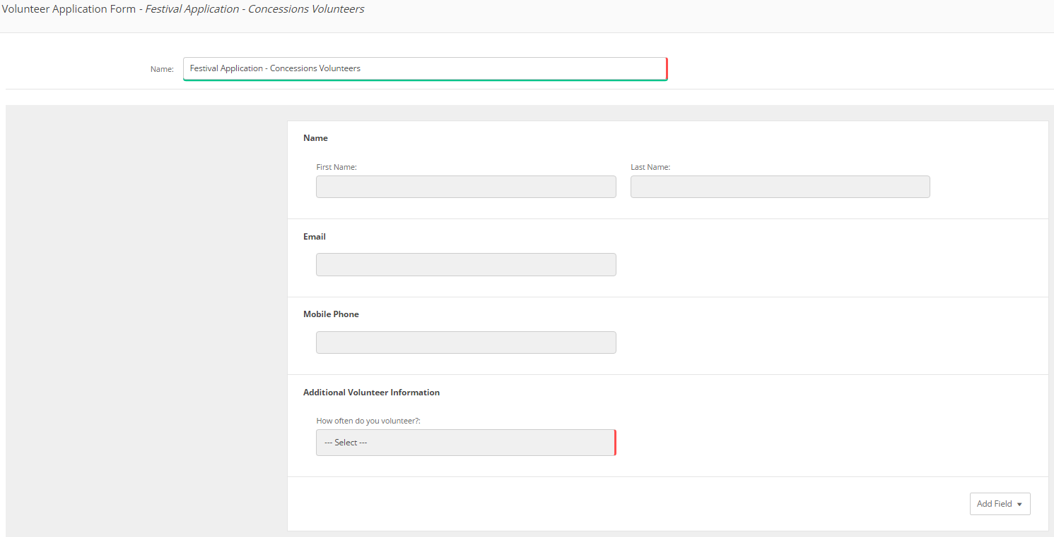
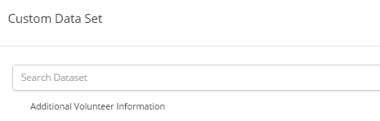
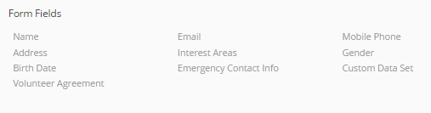

3
Basic Volunteer Opportunities– Requirements, Application Forms
Add an Application Form to your Opportunity in Requirements to capture more info on your volunteers at signup
Title your Form, and begin by adding fields that you want to capture
Adding a Custom Data Set from form fields allows you to insert the questions you created in Configurations→ Custom Data Sets and embed them in the opportunity application form
You can also create your forms by opening the main menu and navigating to

Slide 29

3
Basic Volunteer Opportunities– Requirements
The last requirement we’ll cover is Auto Log Hours When Marked As Attended
This relates to volunteer management and logging of volunteer hours. With this setting turned on, if you mark a volunteer’s attendance as “Attended” the system will auto log that volunteer’s shift hours so you do not need to manually put in how long they volunteered
Auto Check Out Type will not be covered in this guide – it is a setting for an add on product called Time It! for volunteer check-in

Slide 30
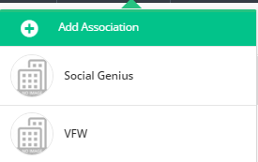
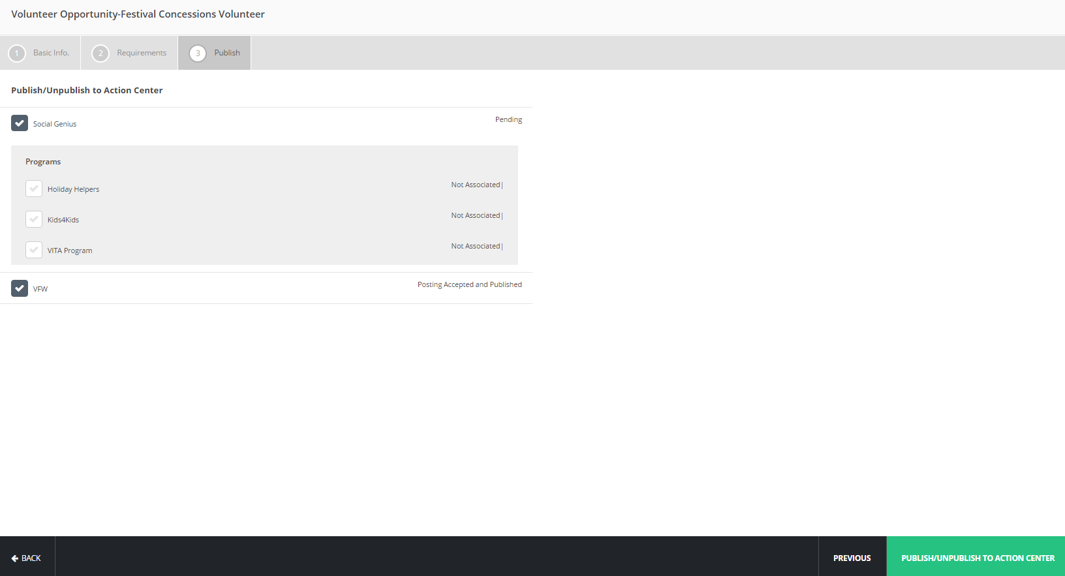
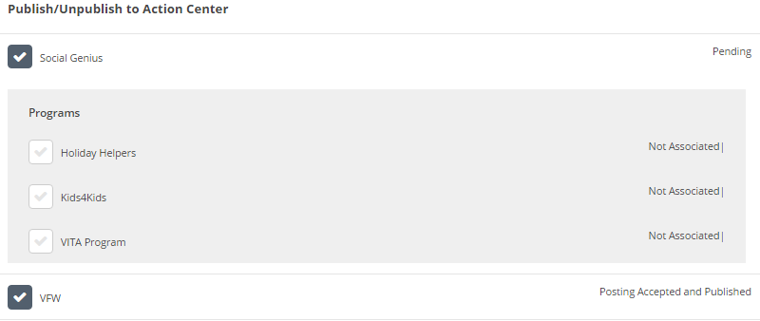


3
Basic Volunteer Opportunities– Publish to Volunteer Center
It’s time to Publish to the “Action Center” - the Volunteer Center’s Public Portal
If you are associated to more than one volunteer center using Fundly Connect it will show here
Programs that the Volunteer Center offers are optional selections that you may wish to associate your opportunity with
The status of your post will be listed here – Pending, Published
You can verify your associations and status with the Volunteer Center
Make sure the Volunteer Center is

Slide 31
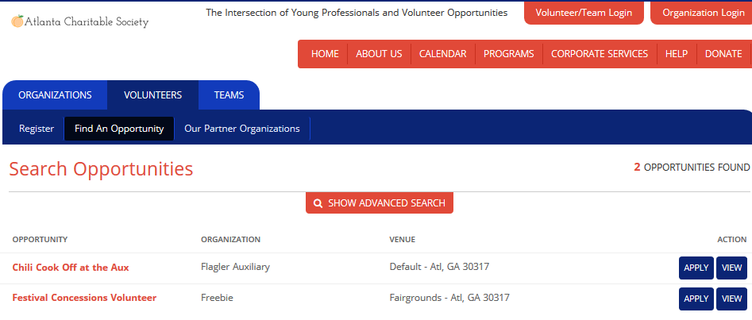
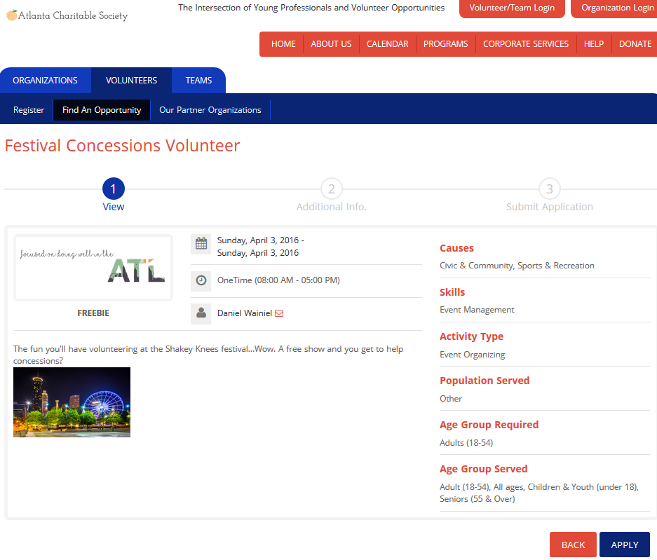
3
Basic Volunteer Opportunities–Opportunity Posting
Navigate to the Volunteer Center’s Public Portal
Search All Opportunities and View your opportunity Festival Concessions Volunteer
Your opportunity has been successfully published
Some Volunteer Centers require approval when processing opportunities from their partner nonprofits. If this scenario exists, your opportunity posting will be ‘approved’ by the Volunteer Center and subsequently posted to the site once they have reviewed

Slide 32
Advanced Opportunities

Slide 33
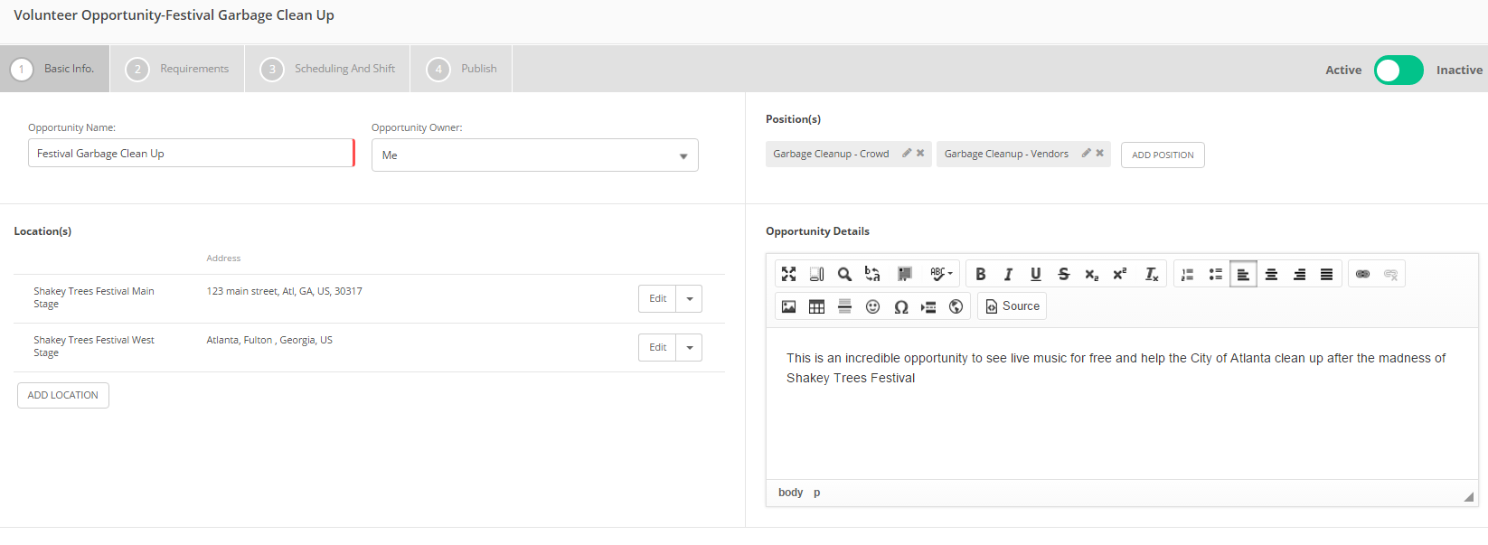
4
Advanced Volunteer Opportunities - Basic Info
Advanced Opportunities include advanced scheduling and shifts, as well as multi locations
Create another opportunity similar to the first one, but create one that will have shifts, weekly recurrences, multi locations, and multi positions
Go through Requirements like we did in Basic Opportunities and move on to Step 3 to fill out your scheduling and shift information
Try using a different application form for this opportunity

Slide 34
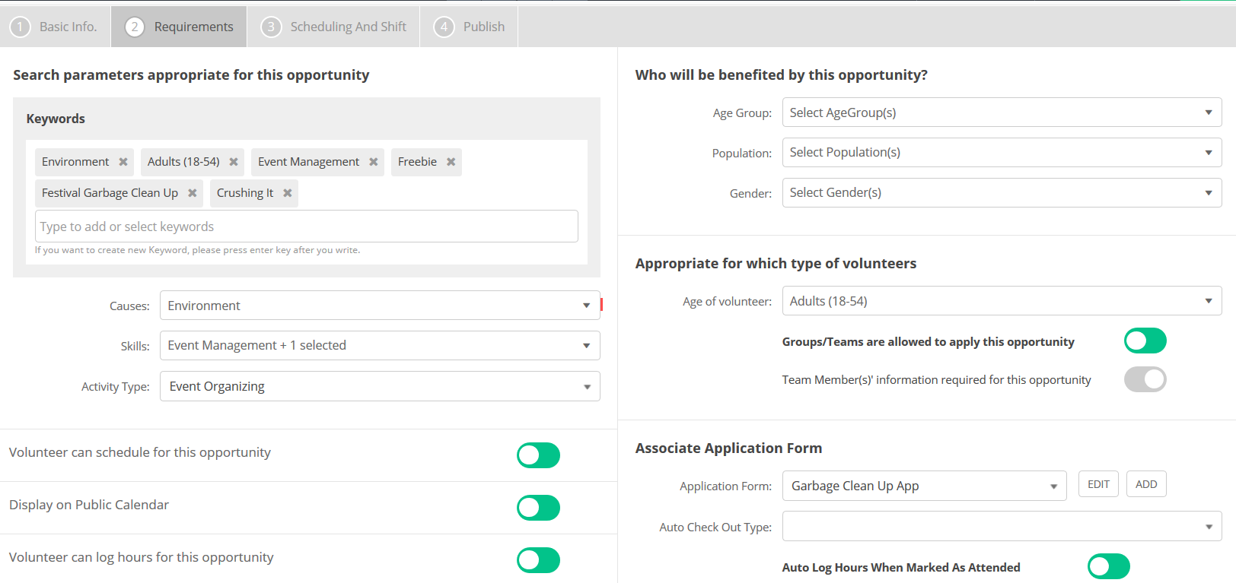
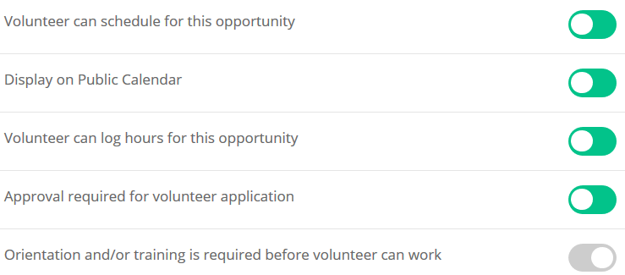
4
Advanced Volunteer Opportunities - Requirements
In this opportunity we’ve turned off
meaning that when a team captain
applies a team to volunteer,
he/she does not need to insert the
names and emails of others on the
team
We’ve also made it so Volunteers can schedule and log hours for the opportunity, but we are requiring approval of volunteer applications

Slide 35
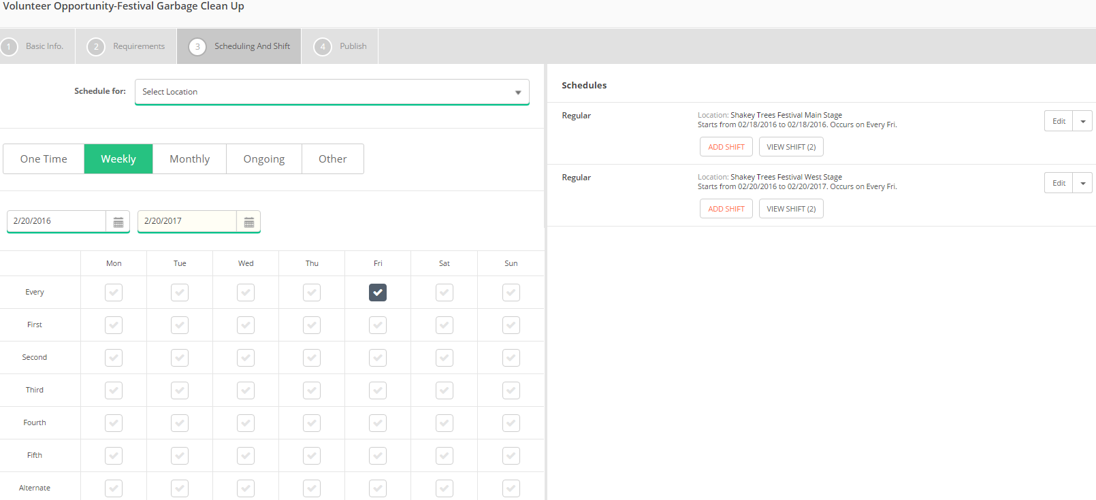
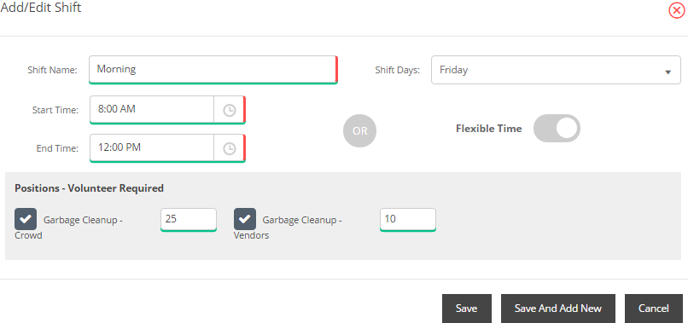
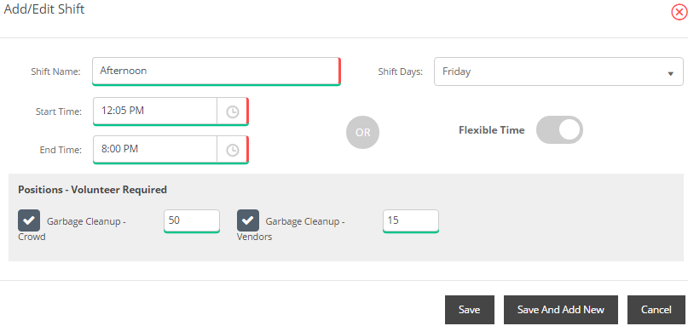
4
Advanced Volunteer Opportunities– Scheduling and Shift
Select the scheduling for your first location: Main Stage
This event is Weekly, every Friday from 2/20/16-2/20/17
Once you input your schedule it is time to create shifts for your positions
Create a Morning and Afternoon Shift for this location and input the number of volunteers needed by position
Repeat for second location: West Stage
You should have 2 schedules with 2 positions, and 2 shifts for each, then go Publish!

Slide 36



4
Advanced Opportunities–Opportunity Posting
Now view Festival Garbage Cleanup Opportunity
Notice for the advanced opportunity there are multiple venues/schedules
The volunteer can message the coordinator from this screen and review the opportunity details
All of the Opportunity Details you setup earlier show up on the Volunteer Center’s public site

Slide 37
Scenario 1

Slide 38



5
Scenario #1
Mike has been finding volunteer opportunities through the volunteer center for many years. He is excited for a new dashboard and the ability to better manage his volunteer calendar
Mike is very selective with the organizations he works with and has affinities for music and environmental preservation
Mike also leads a team of accounting volunteers, The CPAs
He sees an opportunity on the Volunteer Center Portal to volunteer at an upcoming festival that your nonprofit is sponsoring…

Slide 39







5
Scenario #1 - Volunteer Application
1. Mike views your opportunity on the Volunteer Center Portal and it looks like a perfect fit
2. Mike clicks apply, logs in to Fundly Connect and Applies as an Individual
3. Mike is required to fill out fields in the form you configured for the opportunity (Name, Email, Phone, Custom Data Sets) and submits his application. Since he is already a user, many of the fields auto-fill for him

Slide 40

5
Scenario #1 – Automated Message Sent
Your organization will receive an email notification informing you have a new volunteer to approve
You can click on Process in the email and that will take you to your Pending Volunteers or simply login to your Opportunity Dashboard

Slide 41



5
Scenario #1 - Volunteer Approval
You login to your opportunity dashboard and see a new volunteer awaiting approval
Setting from page 18
enforces you to approve the
application for volunteers
Click on your volunteers awaiting
approval to approve your
Festival Garbage Clean Up
volunteer (Mike Wain)

Slide 42


5
Scenario #1 - Volunteer Approval Continued
Select Approve to make the pending volunteer an active volunteer
Review the volunteer application form if you’d like
3. Go back to Your Opportunity List
and click Festival Garbage
Cleanup or on the Active
Volunteer number
4. This will open up scheduling,
check-in and logging hours
volunteer management for your
opportunity

Slide 43



5
Scenario #1 – Volunteer Scheduling
You now need to schedule the
volunteer for the opportunity
1. Click on Scheduling and
select the Venue, Shift,
Position
2. Remember we set up the
opportunity for a weekly
Friday occurrence.
3. Schedule availability by date
to pull up a list of Friday dates

Slide 44


5
Scenario #1 – Logging Hours
Now we are logging hours for Mike, and the volunteer assignments/dates appear on screen that you can log hours for.
If Opportunity Setting
is turned on, the volunteer can log
their own hours from their
dashboard.
The other way to log hours is to click on Attendance and check the volunteer into their scheduled shift for a specific date…

Slide 45


5
Scenario #1 - Attendance
Another volunteer management action we can take is checking in volunteers as attended or no shows. When you click that a volunteer has Attended the volunteer shift, their hours are Auto Logged. (Setting on page 20)
You will need to click Get Attendees once you search by date. You can sort by location, shift, or you check in volunteers by name search once you’ve established your date. if you hover over the check in window, you also have a no show option which logs 0 hours for the volunteer

Slide 46
Scenario #2

Slide 47


6
Scenario #2 – Team Volunteer Application
1. This time Mike is applying his team,
The CPAs for the volunteer
opportunity
2. Mike selects the size of his team and
submits the application
3. Notice the names and emails of the
volunteers on his team are not
required upon submittal for this
opportunity (see page 32)

Slide 48

6
Scenario #1 – Automated Message Sent
Your organization will receive an email notification informing you have a new team to approve
You can click on Process in the email and that will take you to your Pending Volunteers or simply login to your Opportunity Dashboard

Slide 49


6
Scenario #2 – Team Volunteer Application
You can now approve the team. If you click the you will be able to enter in team member names if they are volunteer records in your Fundly Connect database
Oftentimes, teams won’t know who is attending an opportunity and that is why you would select this setting
Proceed with scheduling your Team for the opportunity just like you would an individual

Slide 50






6
Scenario #2 – Team Volunteer Application
In Attendance, if you check in the Team, the status changes to
Keep in mind the hours calculated when marking as attended will be the total shift time (4 hours) and not the team size (5) multiplied by 4 hours
If you ever need to go in and edit a team’s/individual’s total hours volunteered, Select Manage Volunteers and click on the Hours Volunteered value then the Verified Hours value to pull up the Log Details

Slide 51
Orientations & Trainings

Slide 52

7
Orientations/Trainings– Create a Training Requirement
Training requirements are setup almost exactly like an opportunity, however, they are a precursor setting and requirement a volunteer must fulfill prior to volunteering
Create a name for your training and a capacity as well as location
will allow a volunteer to cancel
a scheduled training from
their dashboard
Fill out your details/schedule and Publish to the Volunteer Center site
Navigate to an opportunity you want to associate a training to

Slide 53



7
Orientations/Trainings– Associate a Training Requirement to an Opportunity
On step 2 of your opportunity, turn on:
Select the training you want to associate with your opportunity and save
When the volunteer applies to an opportunity they will now see this training requirement
On the Volunteer Center Opportunity Calendar you will see a list of trainings as well

Slide 54



7
Orientations/Trainings– Public Calendar RSVP
A volunteer could search the Volunteer Center Portal for your Training dates and RSVP to a specific training date
The calendar can be filtered by opportunities and/or trainings to make it easier for volunteers to find your published activities
When the volunteer clicks
they will be asked to login
and then successfully RSVP for the
training
An RSVP with training dates will also appear when a volunteer applies to an opportunity normally (without going to the calendar)

Slide 55
Scenario #3

Slide 56

8
Volunteer Opportunities–Scenario #3 Volunteer Management (Training Required)
1. Scenario: Volunteer logs in and
applies for opportunity that
requires training prior to
volunteering. A pop up window
appears to Add RSVP
2. Volunteer selects from the list of
available training times and hits
save OR they can RSVP to a training
date/time later from their dashboard
4. Once the Training has been marked
as attended by your organization you
can schedule the volunteer for the
opportunity

Slide 57





8
Volunteer Opportunities– Volunteer Scenario #3 (Training Required)
1. Scenario: Someone at your
organization schedules the
Training for the volunteer
2. Click on your Opportunity volunteer,
Select and Add RSVP for
the volunteer training location, shift,
etc.
3. The Next Step changes from
to
4. Click on Pending Attendance, View
RSVP window opens, mark the
volunteer as Attended
5. Proceed with scheduling the
volunteer for the opportunity

Slide 58
Communication

Slide 59


9
Volunteer Communication
Open up the main menu and navigate to Communication Center Create New
Fill out your sender info/subject
Recipients Type will always be volunteer
Create a New Template for your newsletter and select that template once completed (more on next page)
Select one of the two provided templates (more on next page)
Attach a file up to 4MB

Slide 60


9
Volunteer Communication
Wait 5-10 seconds for your template to load
Drag and drop widgets into your newsletter, upload your logo, change colors, content, and layout
Make sure to name and save your newsletter for future use
This is built in functionality similar to Mailchimp

Slide 61


9
Volunteer Communication
It’s time to select our newsletter recipient list
The default will send to all volunteers with an email and communication preferences turned on
If you want to get granular, you can select filters to build a segment
Ex: All Female Volunteers living in Atlanta
You can also add recipients individually
Save and Proceed to the next step

Slide 62


9
Volunteer Communication
Send a test email to yourself if you want to double check your work
Send now or Send On a certain date/time
Proceed to Communication History

Slide 63



9
Volunteer Communication
Once the email has been Completed, click on View Summary for the communication
You will get email metrics that detail who is opening, clicking, bouncing, and unsubscribing from your newsletter
You may also copy communications for future messaging that is similar

Slide 64
Reports and Miscellaneous

Slide 65



10
Reporting
Out of the box Default Reports are constantly being added. Click on the type of report you are looking to run and hit Execute
If you want to schedule a report to hit your inbox daily, weekly, monthly, etc. you can do that here
You can also set the format you’d like for your report and select reports by category: Opportunity, Volunteer, Training and more

Slide 66

10
Reporting
Enhanced Reports allow you to select your own defined Filters, Sorting and Layout to create a customized report
Dashboard Reports allow you to visualize data so you can chart, map, and understand how your volunteering evolves over time
More information on Reporting can be found online and by attending a webinar on how to utilize the reporting functions Fundly Webinar Events

Slide 67



10
Fundly Connect → Fundly CRM Sync
There is a sync from Fundly Connect to Fundly CRM, so anytime you create a new record in Connect, that record gets pushed into CRM
The record in CRM is automatically labeled as a Volunteer Contact Type and their volunteer hours and opportunities are sent to the
CRM record in the Fundly Connect Information window
To setup this integration, navigate to your configurations in Fundly Connect and Toggle on the Enable Sync setting
Now you can report and communicate using volunteering data and giving!

Slide 68
10
Supporting Material
All NonProfitEasy and Fundly Connect webinars can be found online
Fundly Product Webinars
All Fundly Connect training videos can be found online
Fundly Connect v2.0 Training
Tailored 1x1 training can be scheduled for $100/hour with our training team
Please email your Volunteer Center for support questions
Bi Monthly Call In sessions for Free Partner Agencies can be found online
Bi-Monthly Agency Q/A Sessions
If you are interested in learning more about donor management (Fundly CRM) or starting a crowdfunding or Peer to Peer fundraising campaign (Fundly Pro) please visit http://fundlycrm.com or http://fundly.com/pro and contact sales@fundly.com

